Slide 1
Pass Structure of Assembler
Subject : Systems Programming

Slide 2
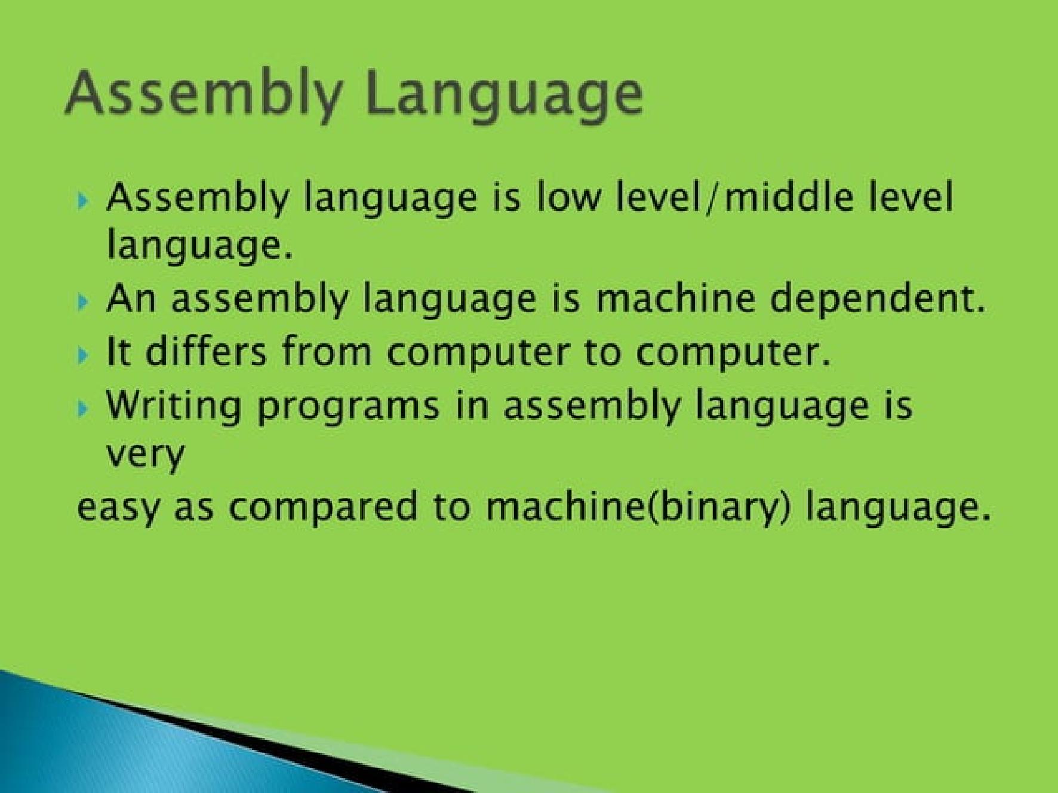

Slide 3
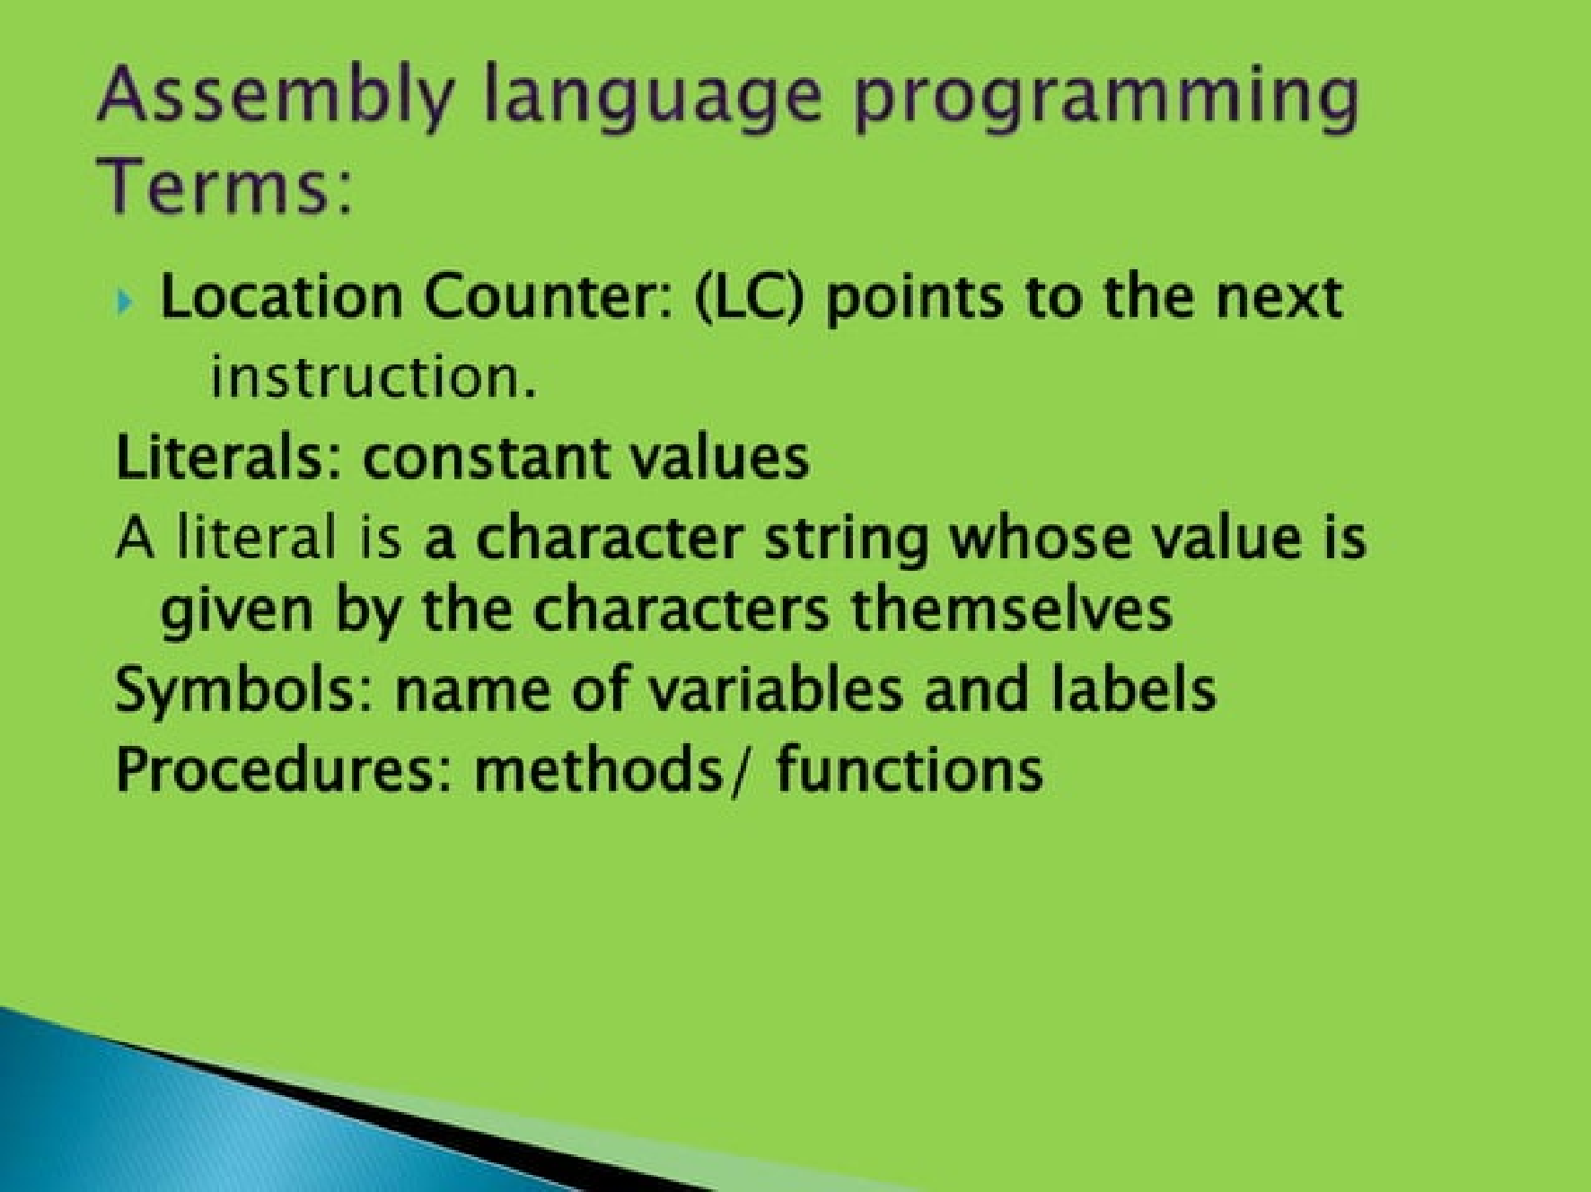

Slide 4
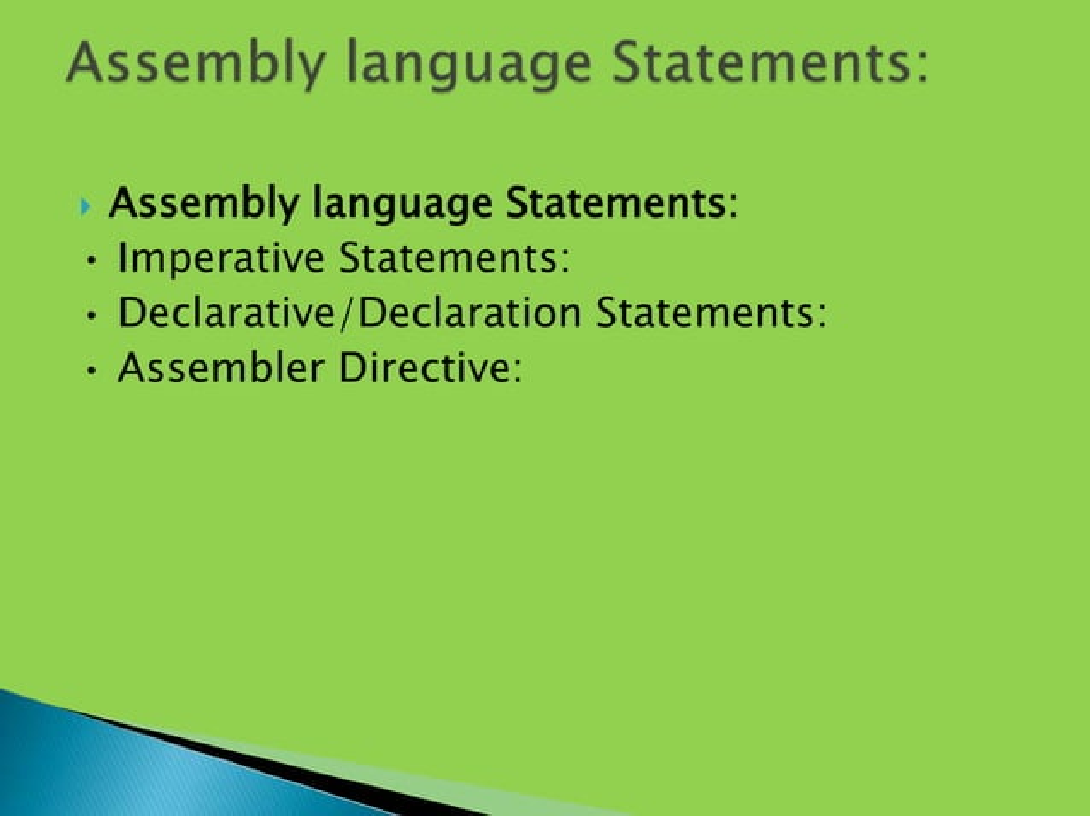

Slide 5
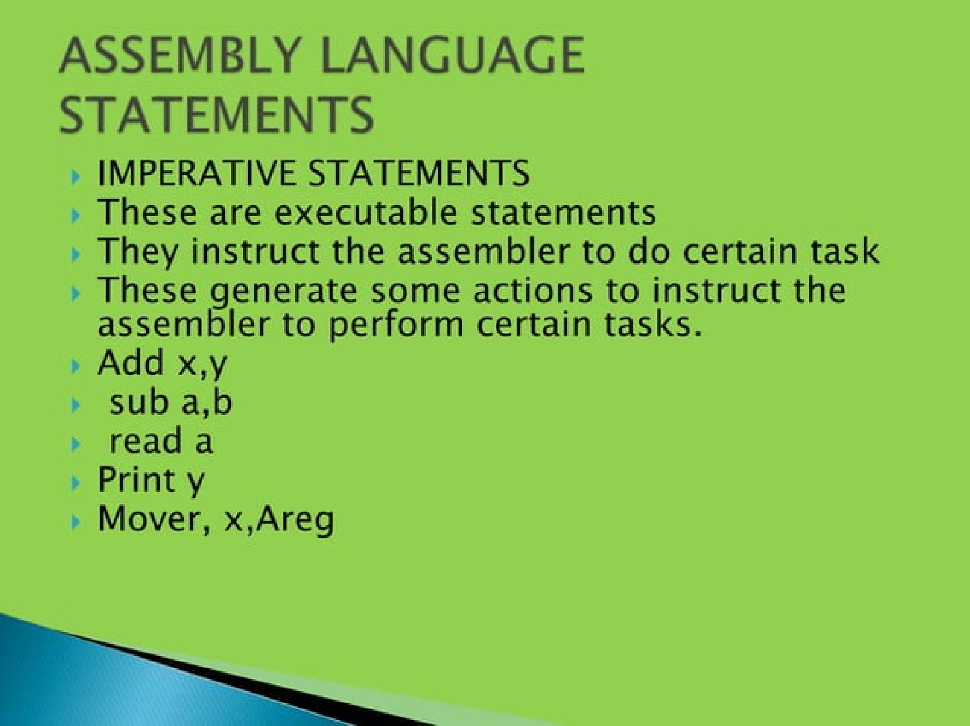

Slide 6
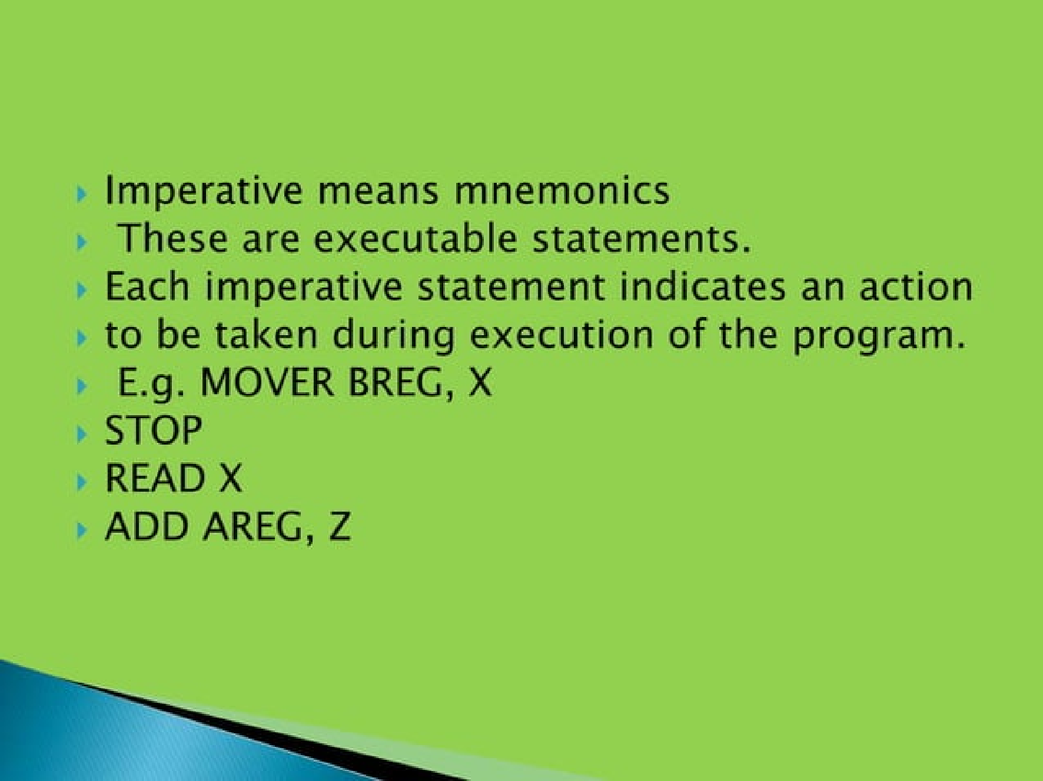

Slide 7
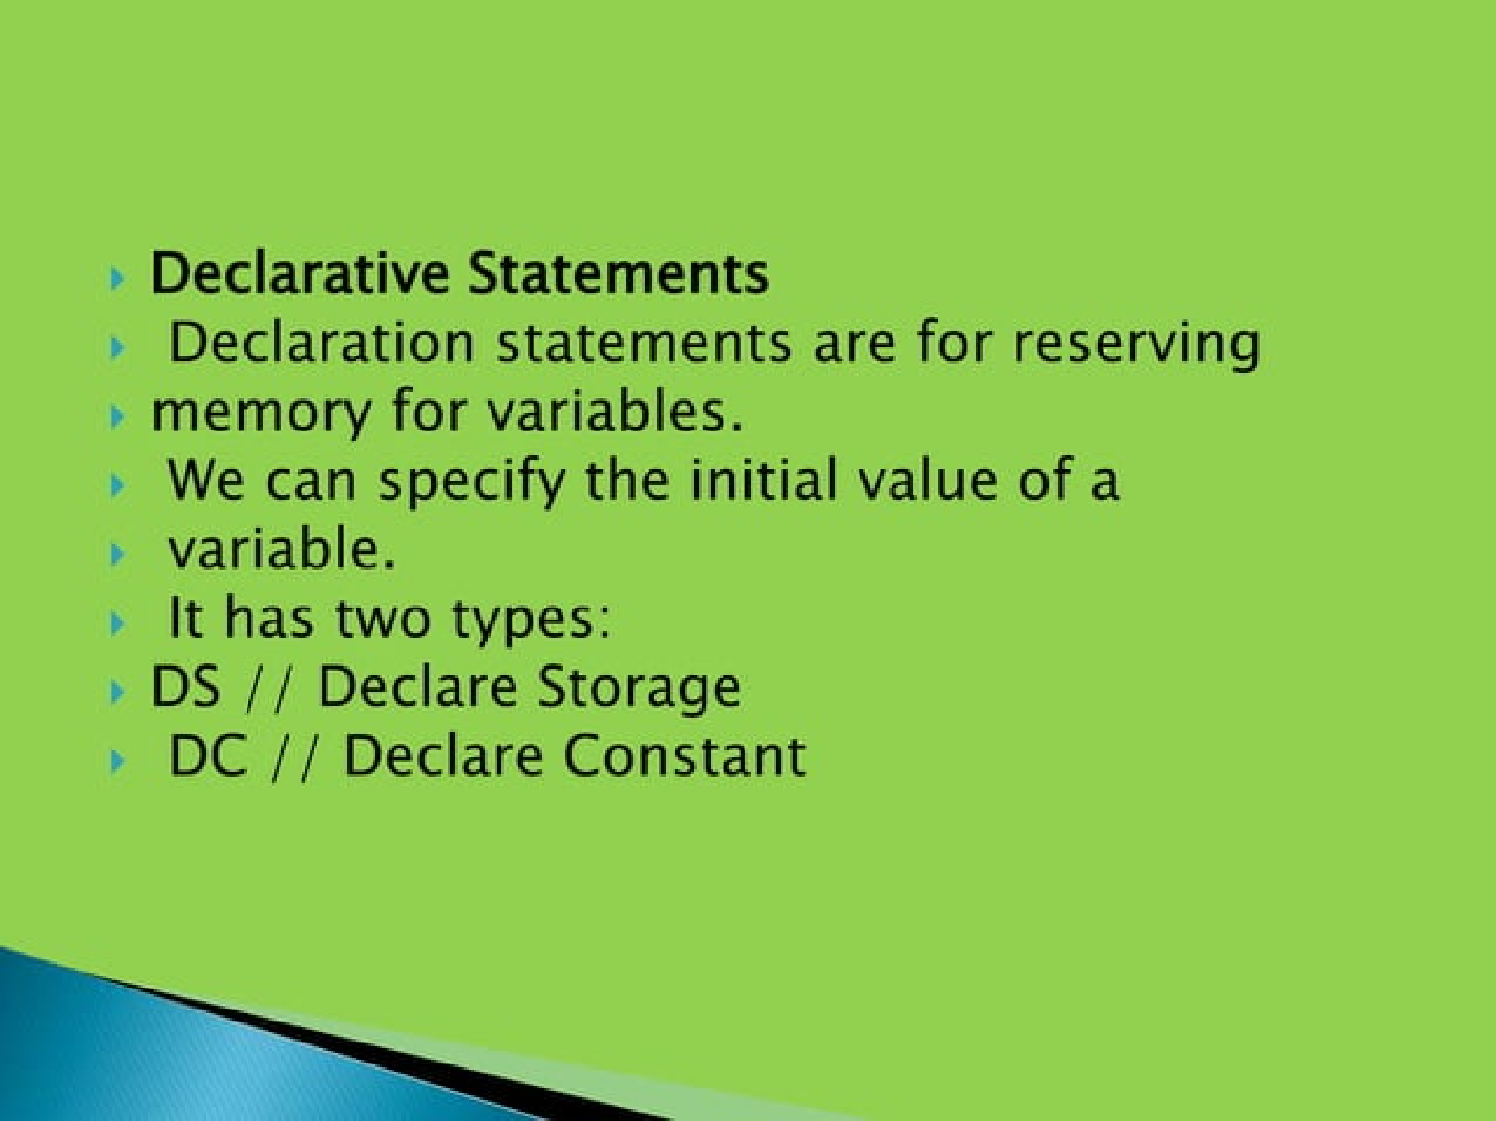

Slide 8
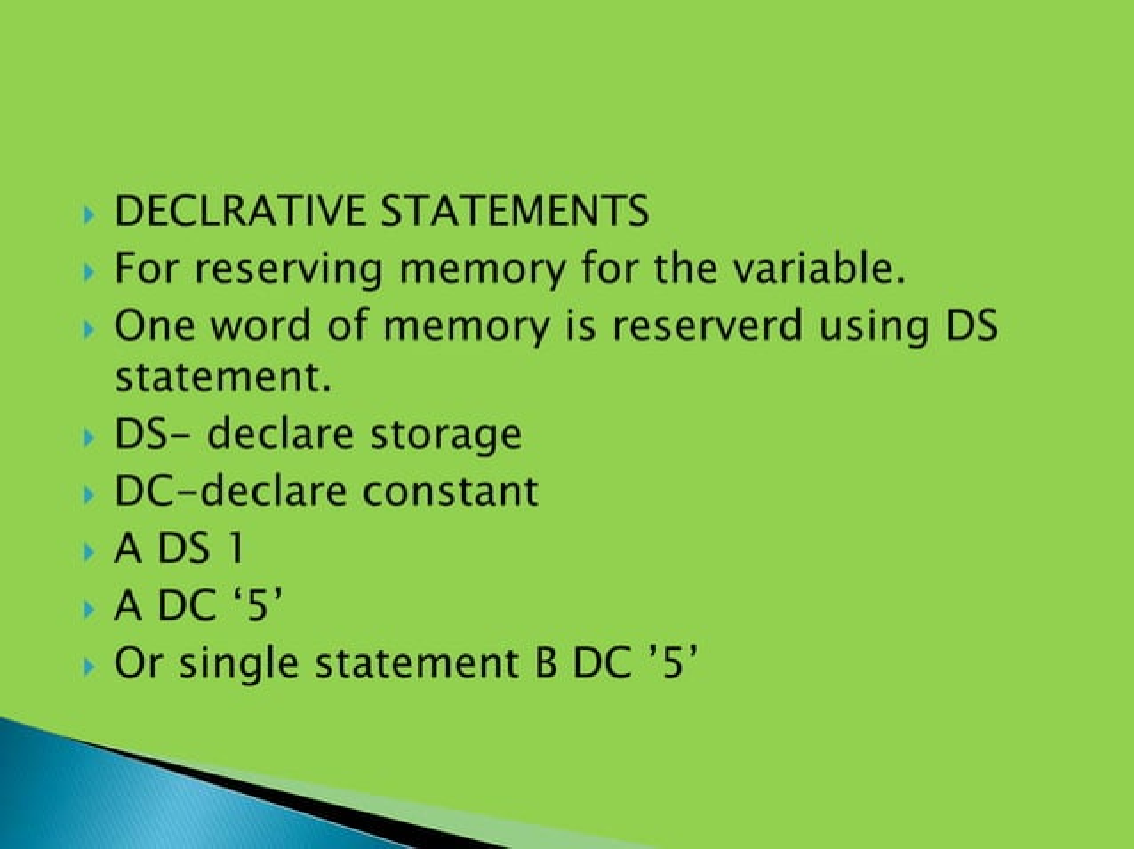

Slide 9
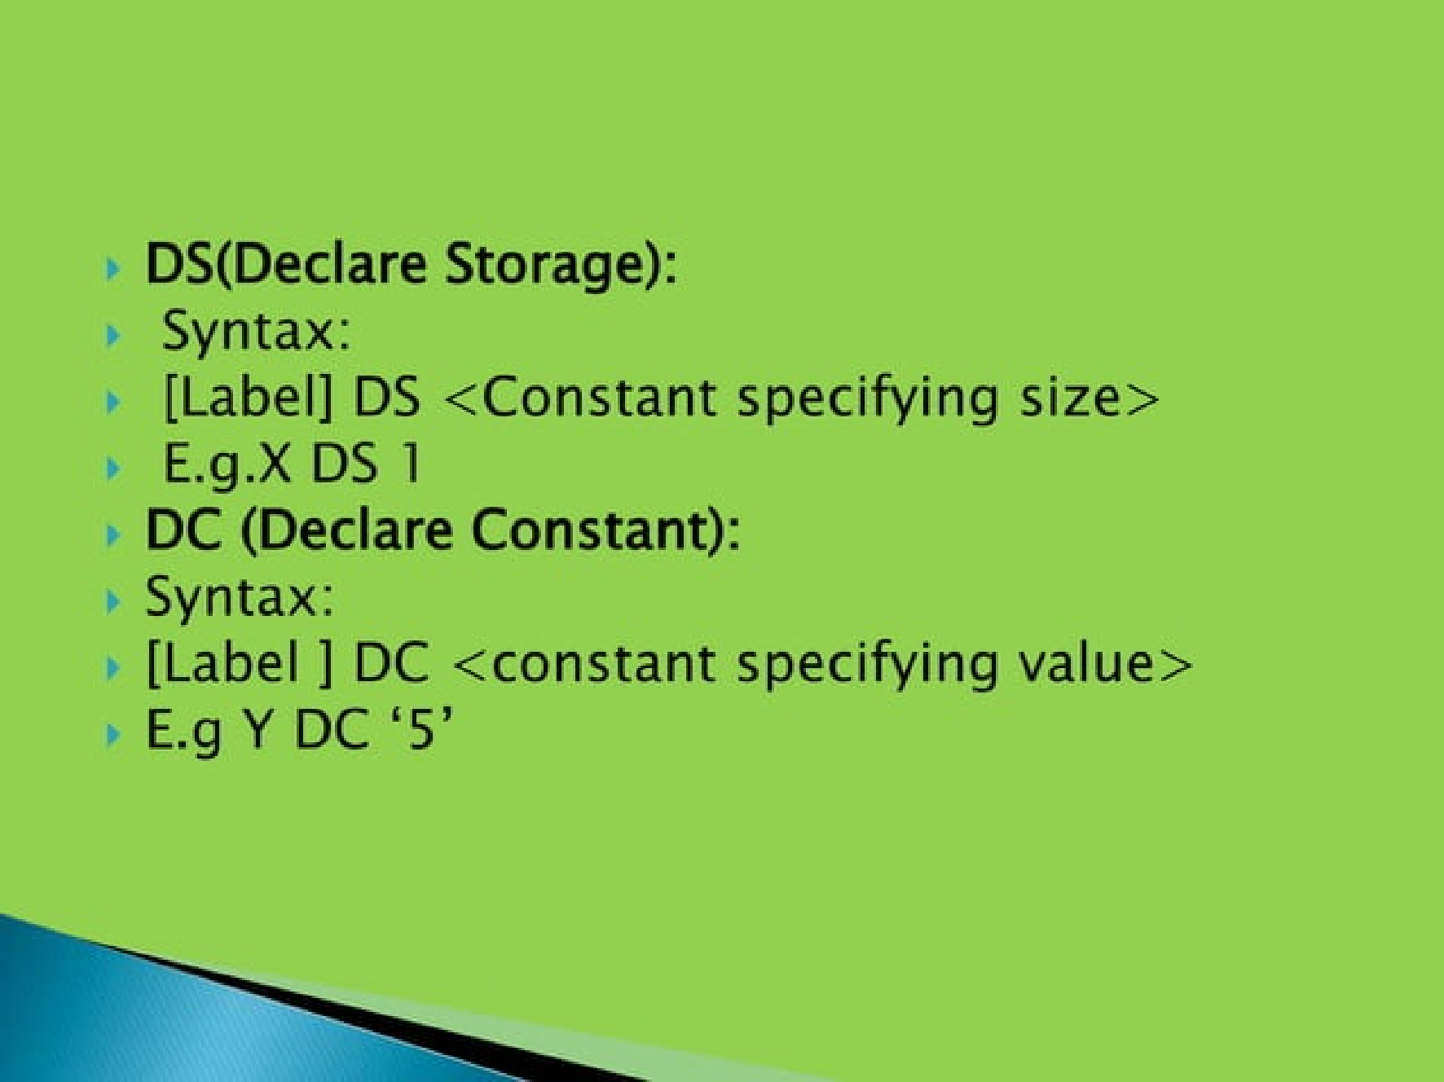

Slide 10
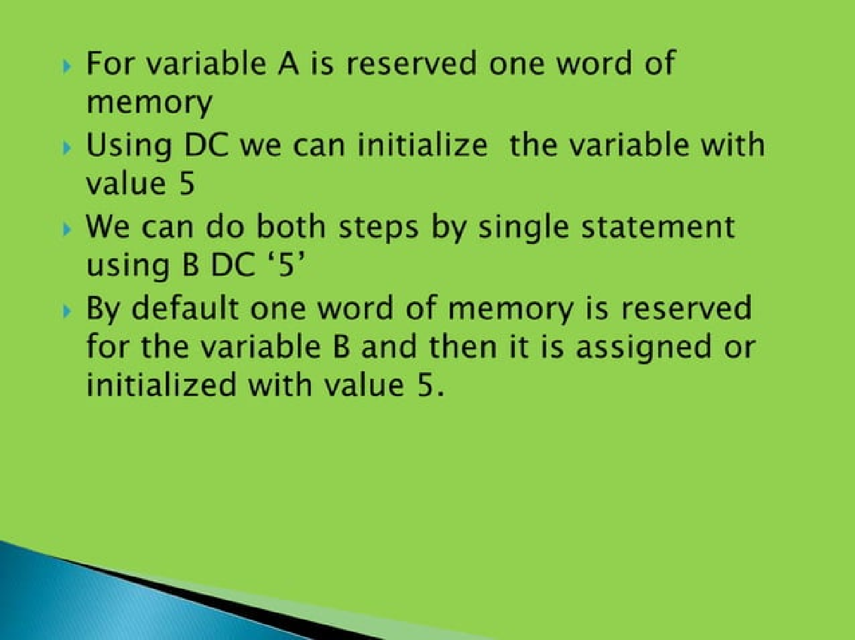

Slide 11
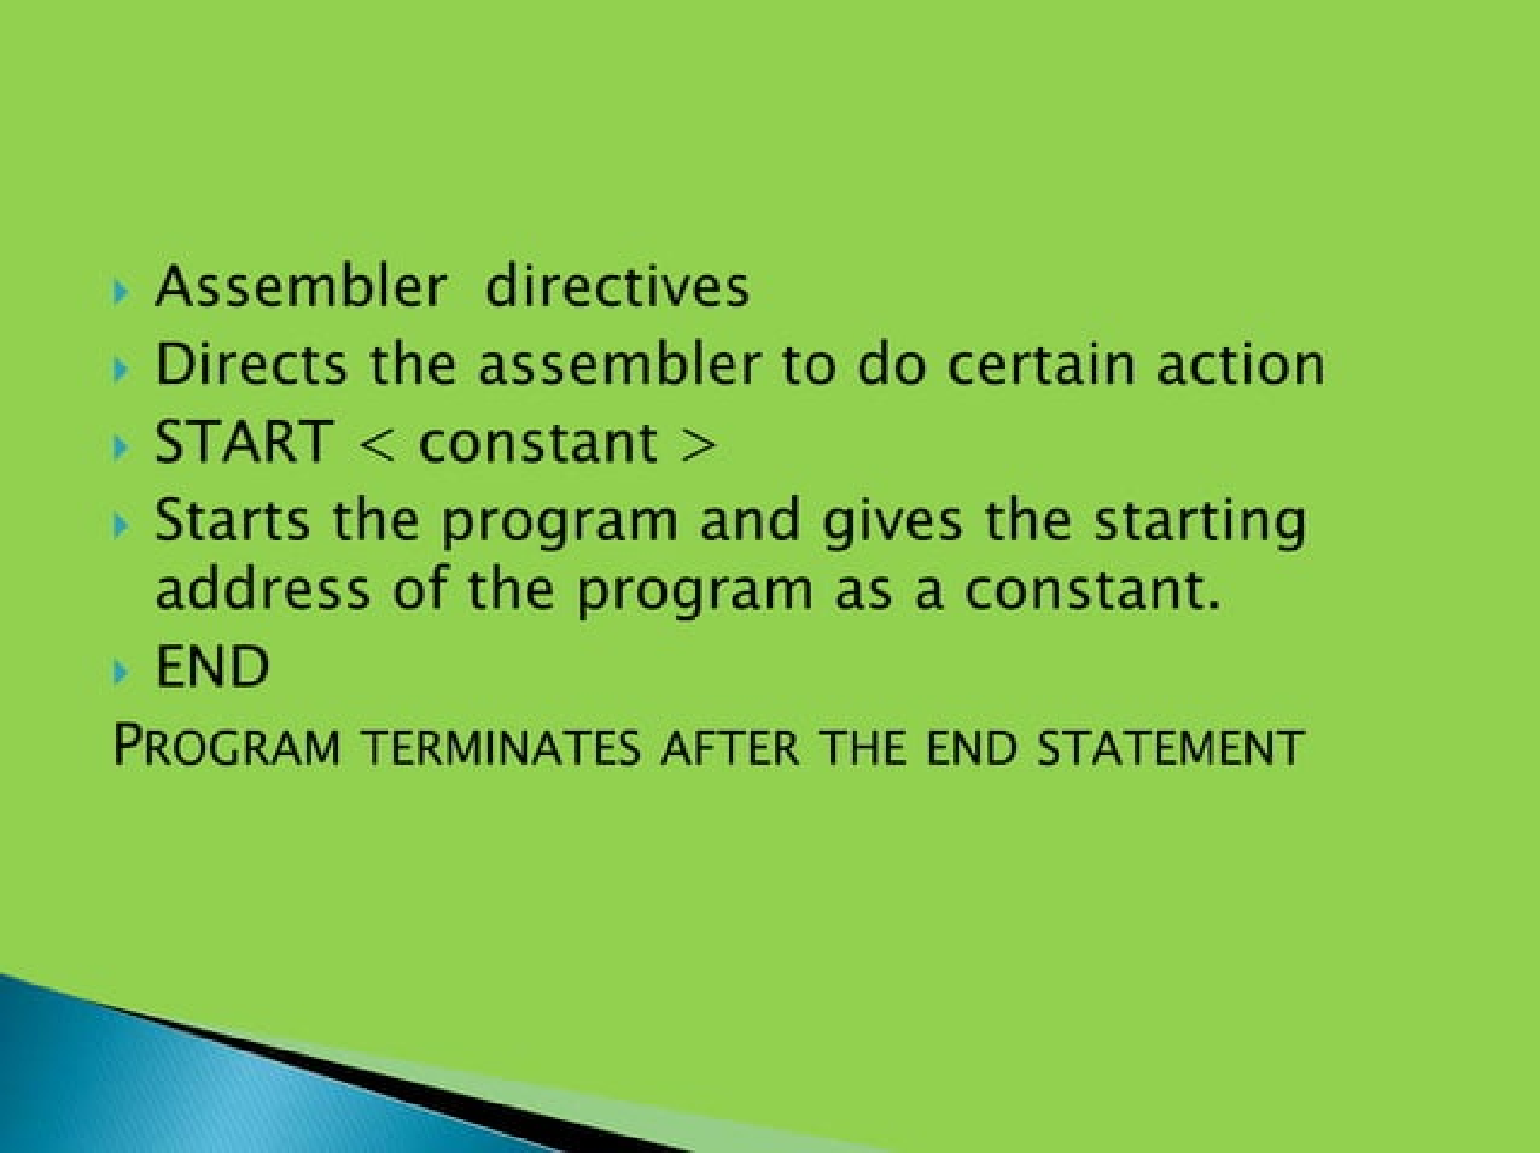

Slide 12
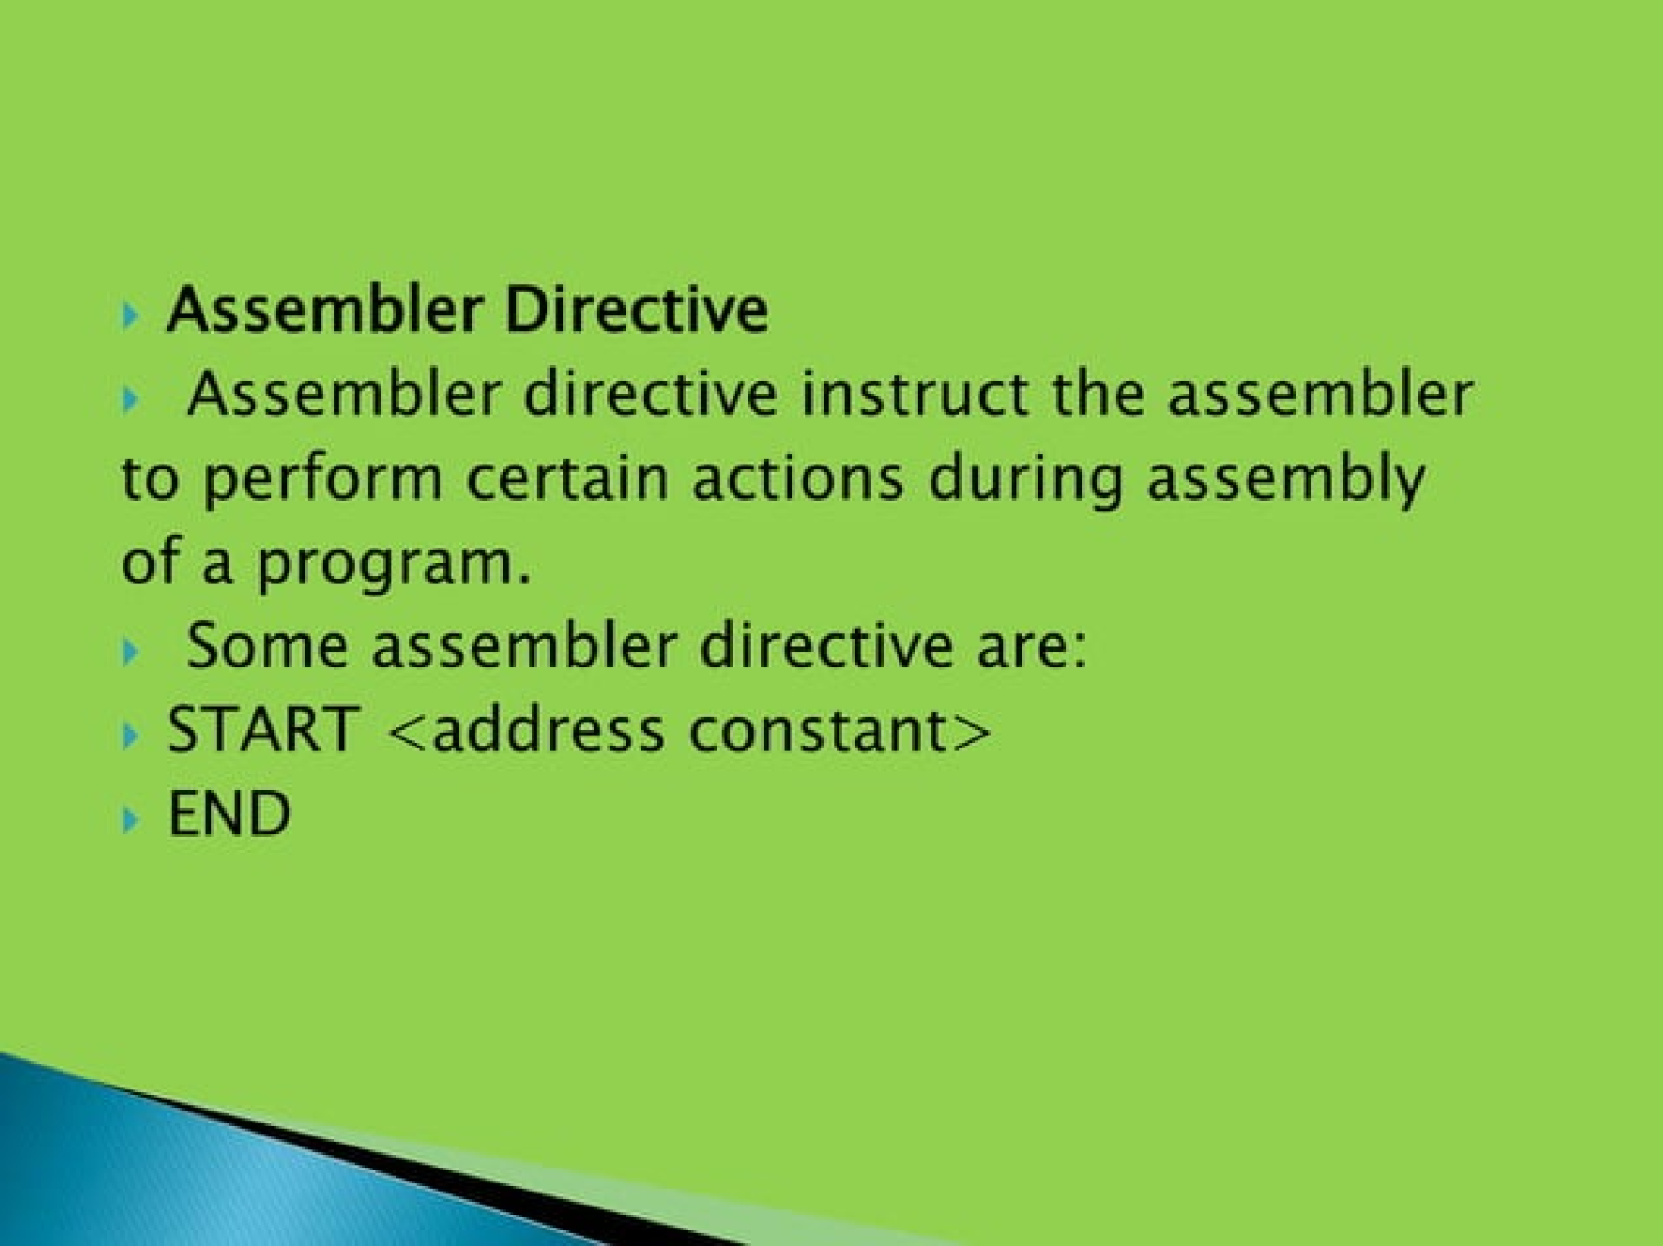

Slide 13
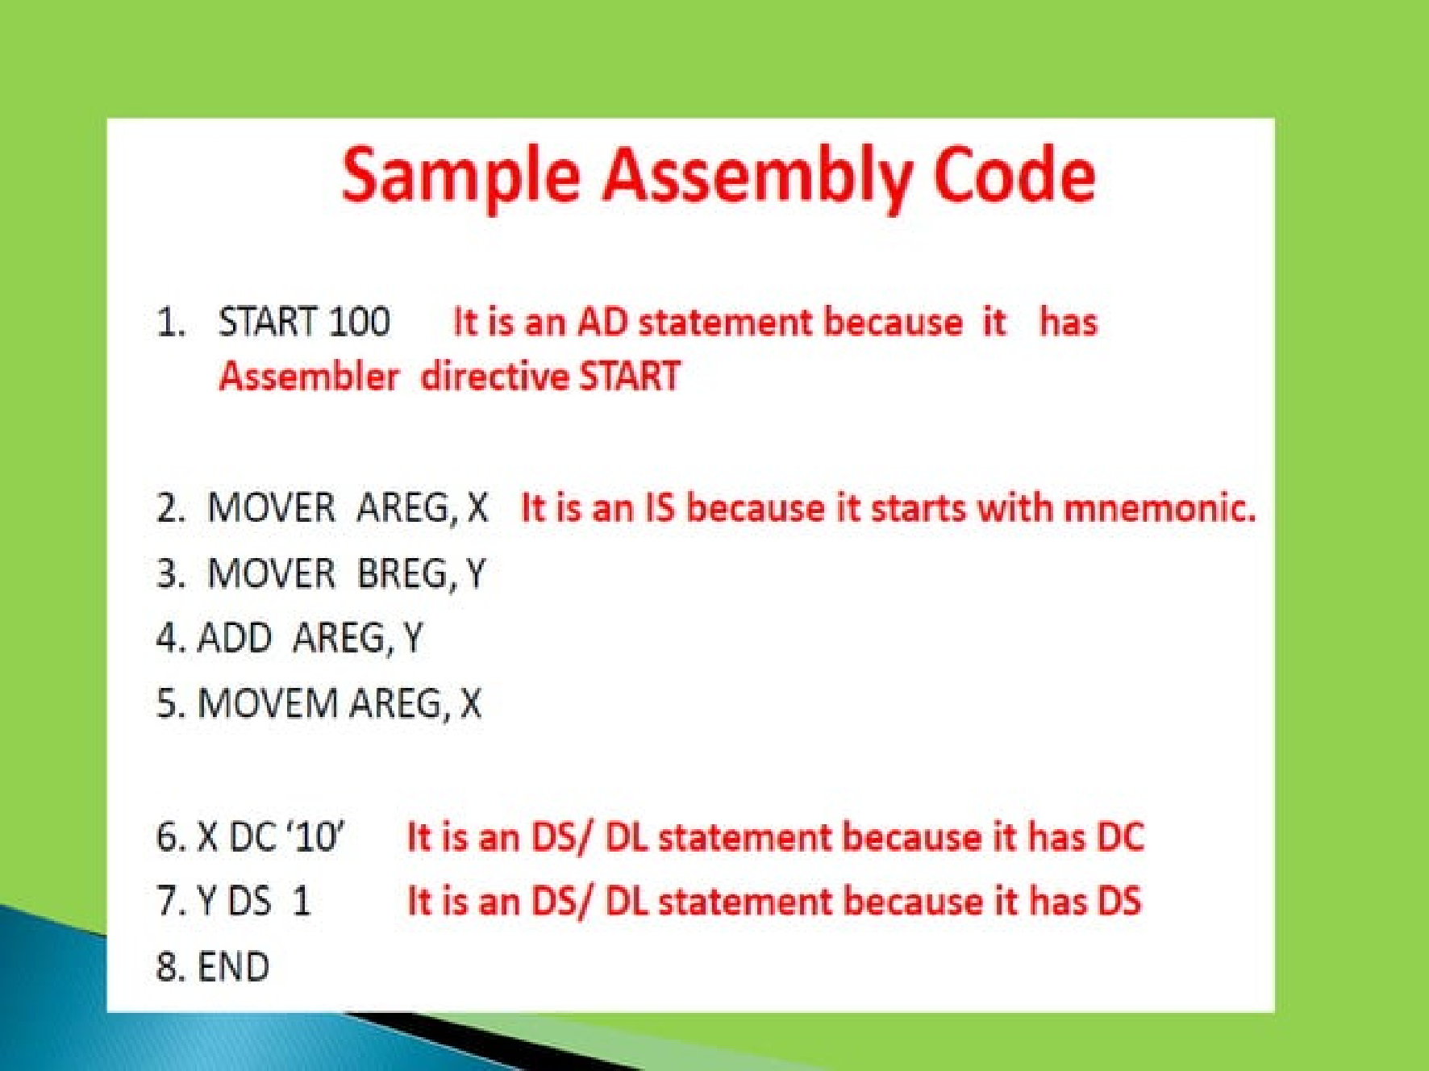

Slide 14
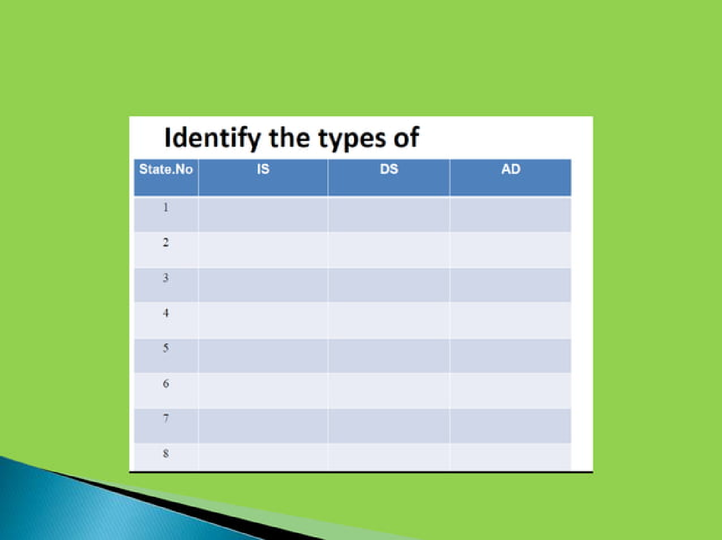

Slide 15
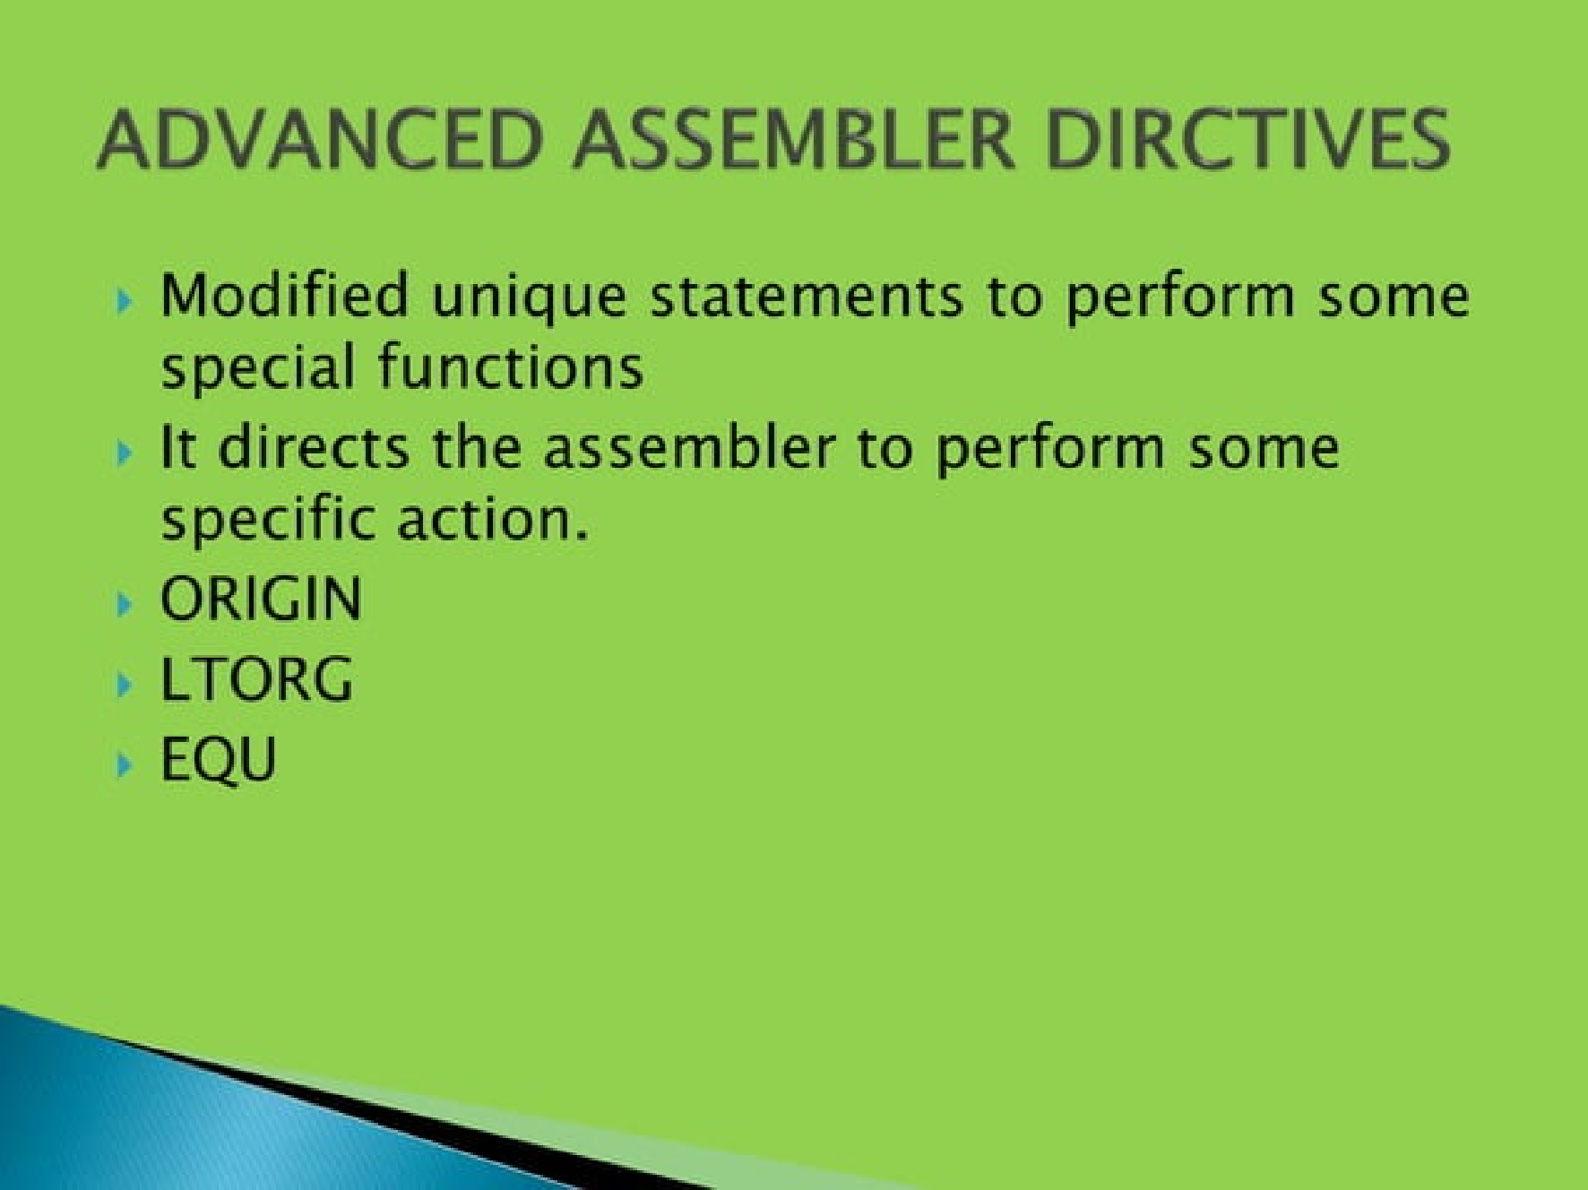

Slide 16
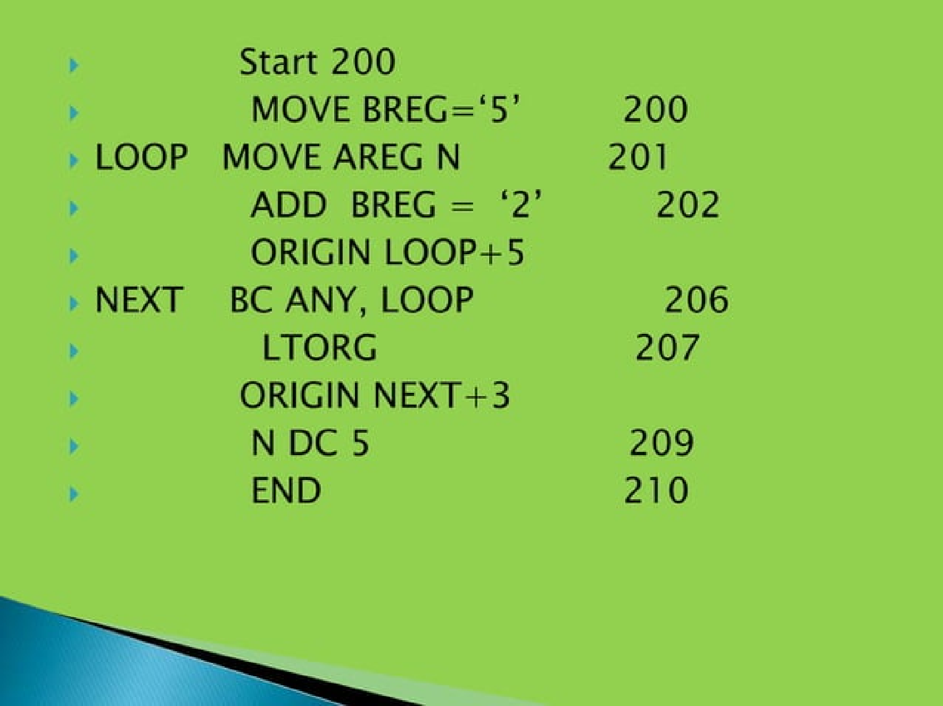

Slide 17
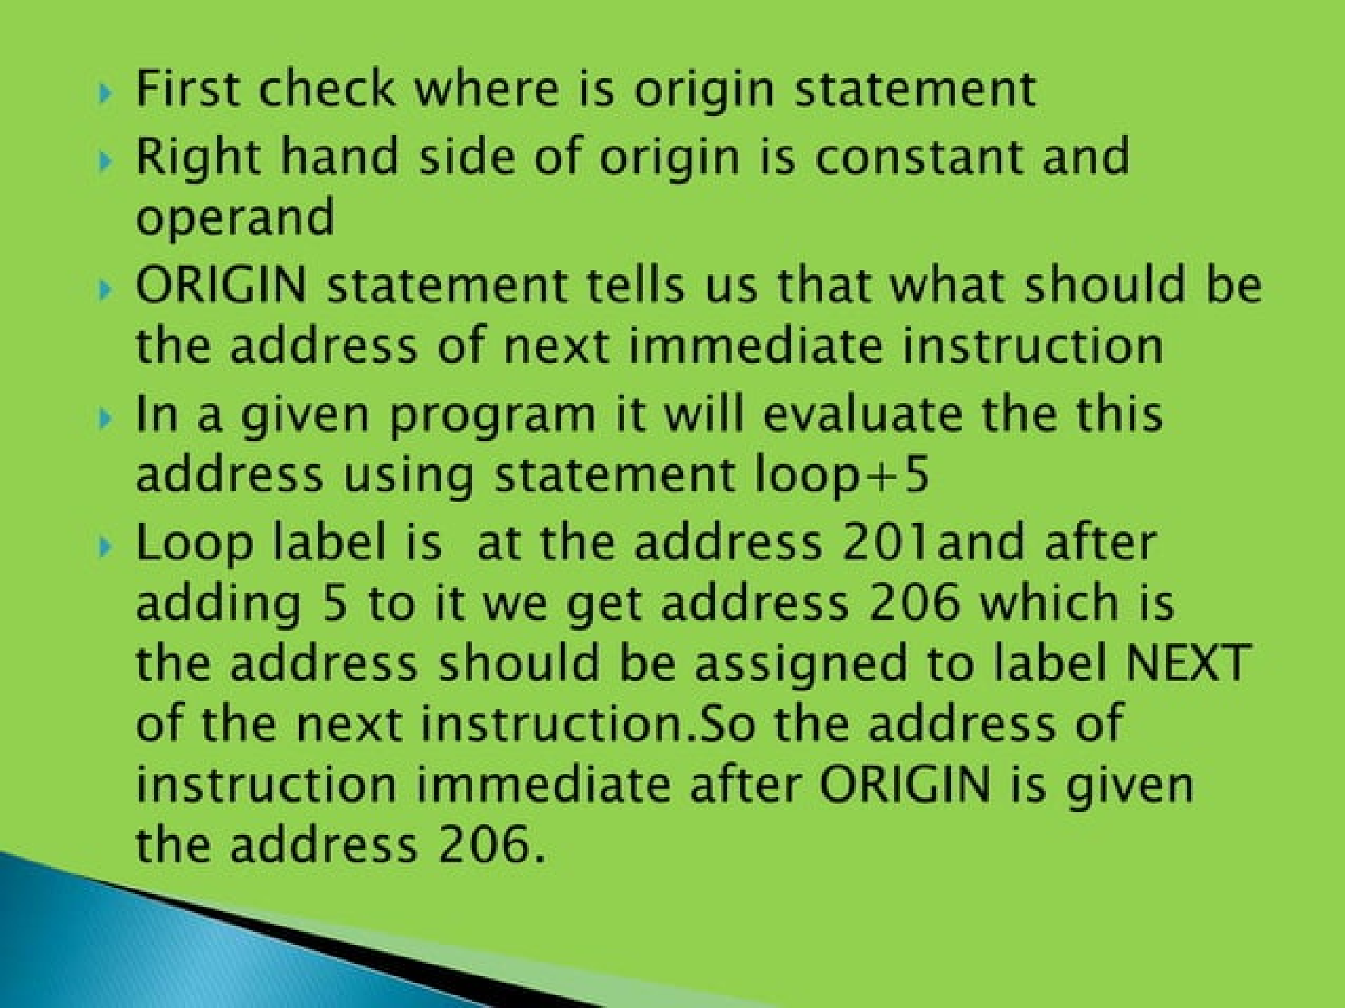

Slide 18
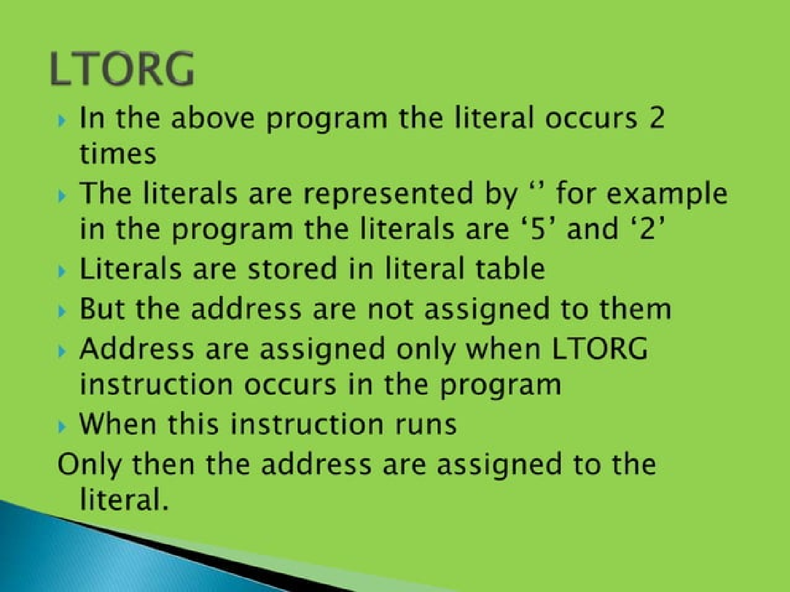

Slide 19
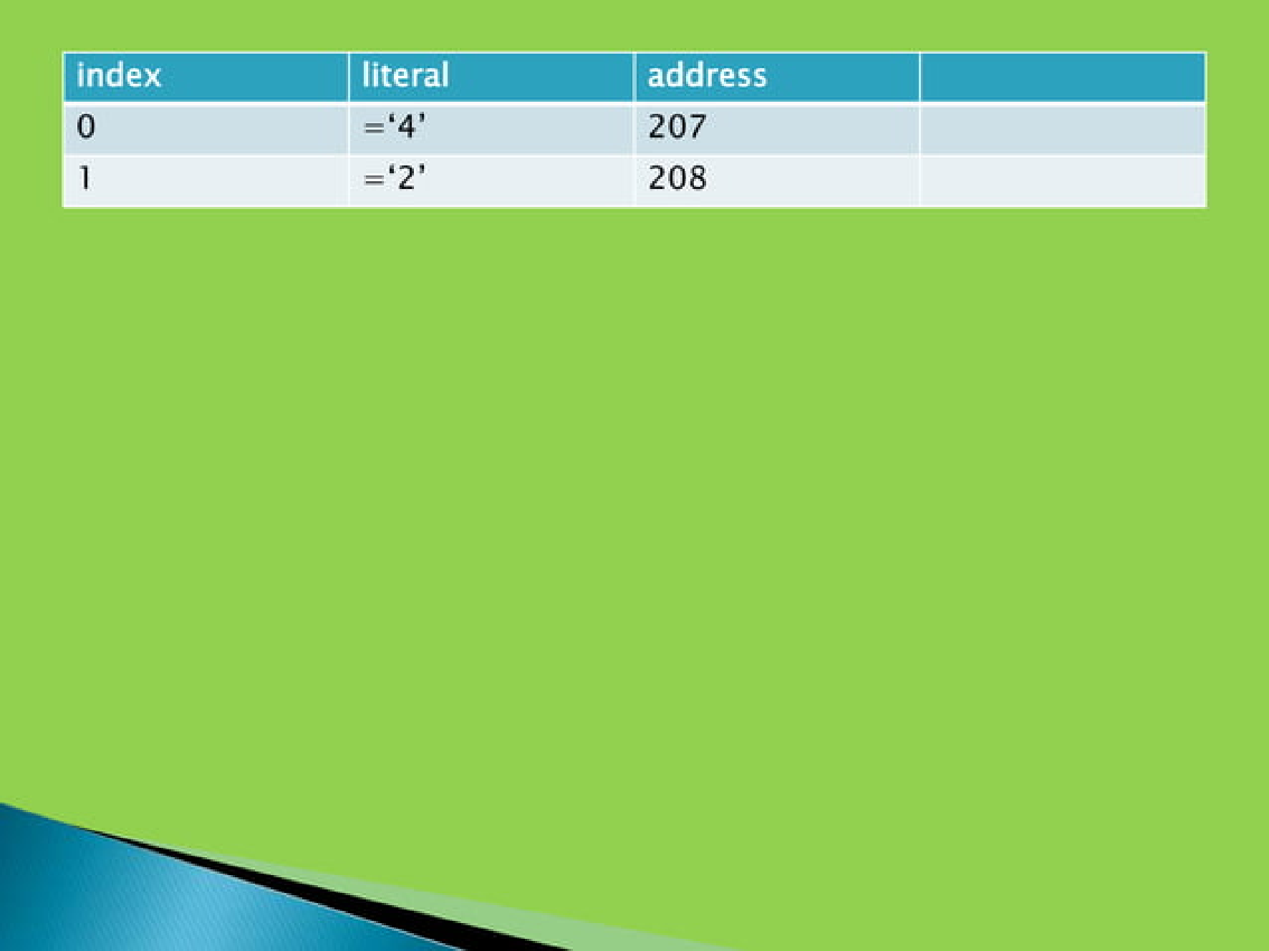

Slide 20


Slide 21
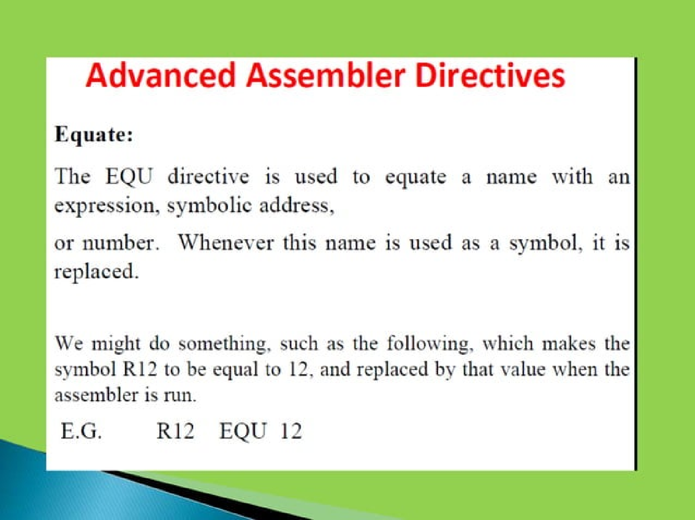

Slide 22
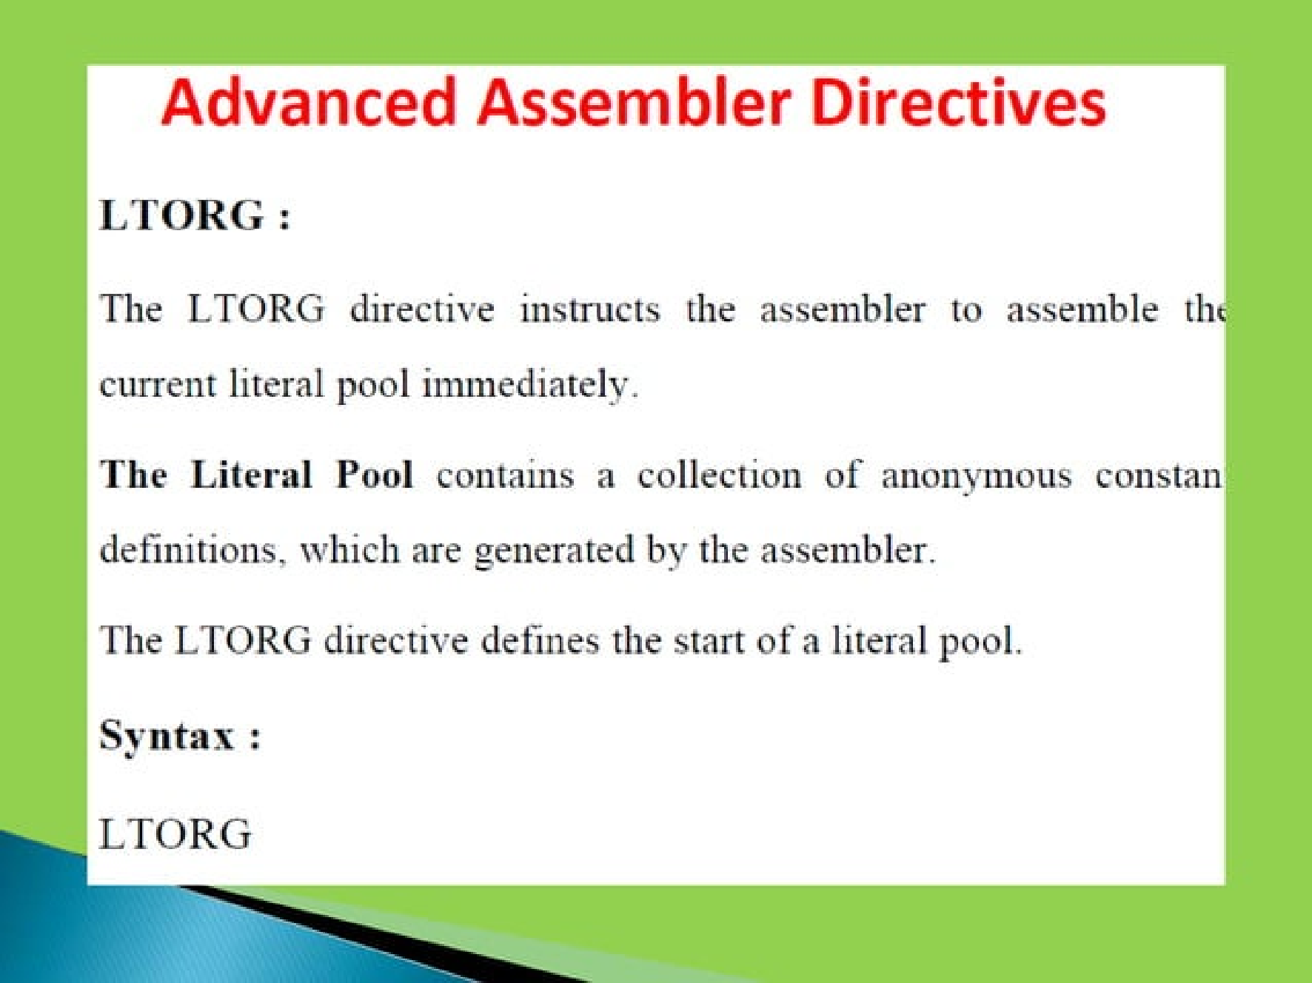

Slide 23
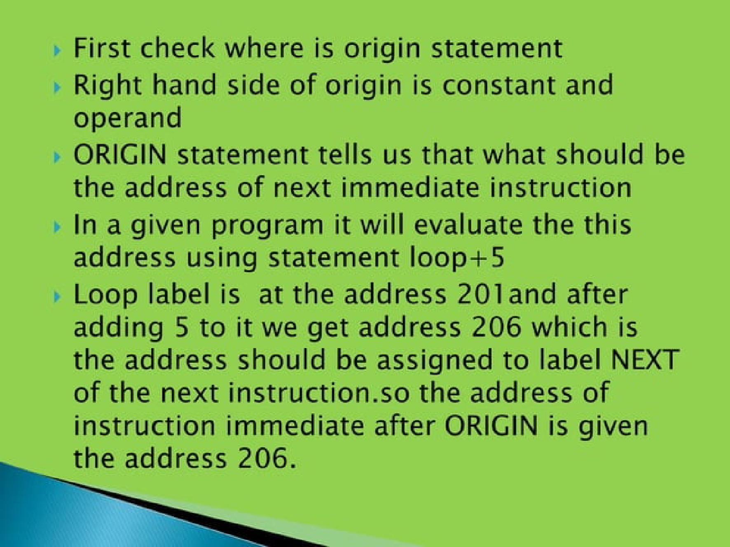

Slide 26
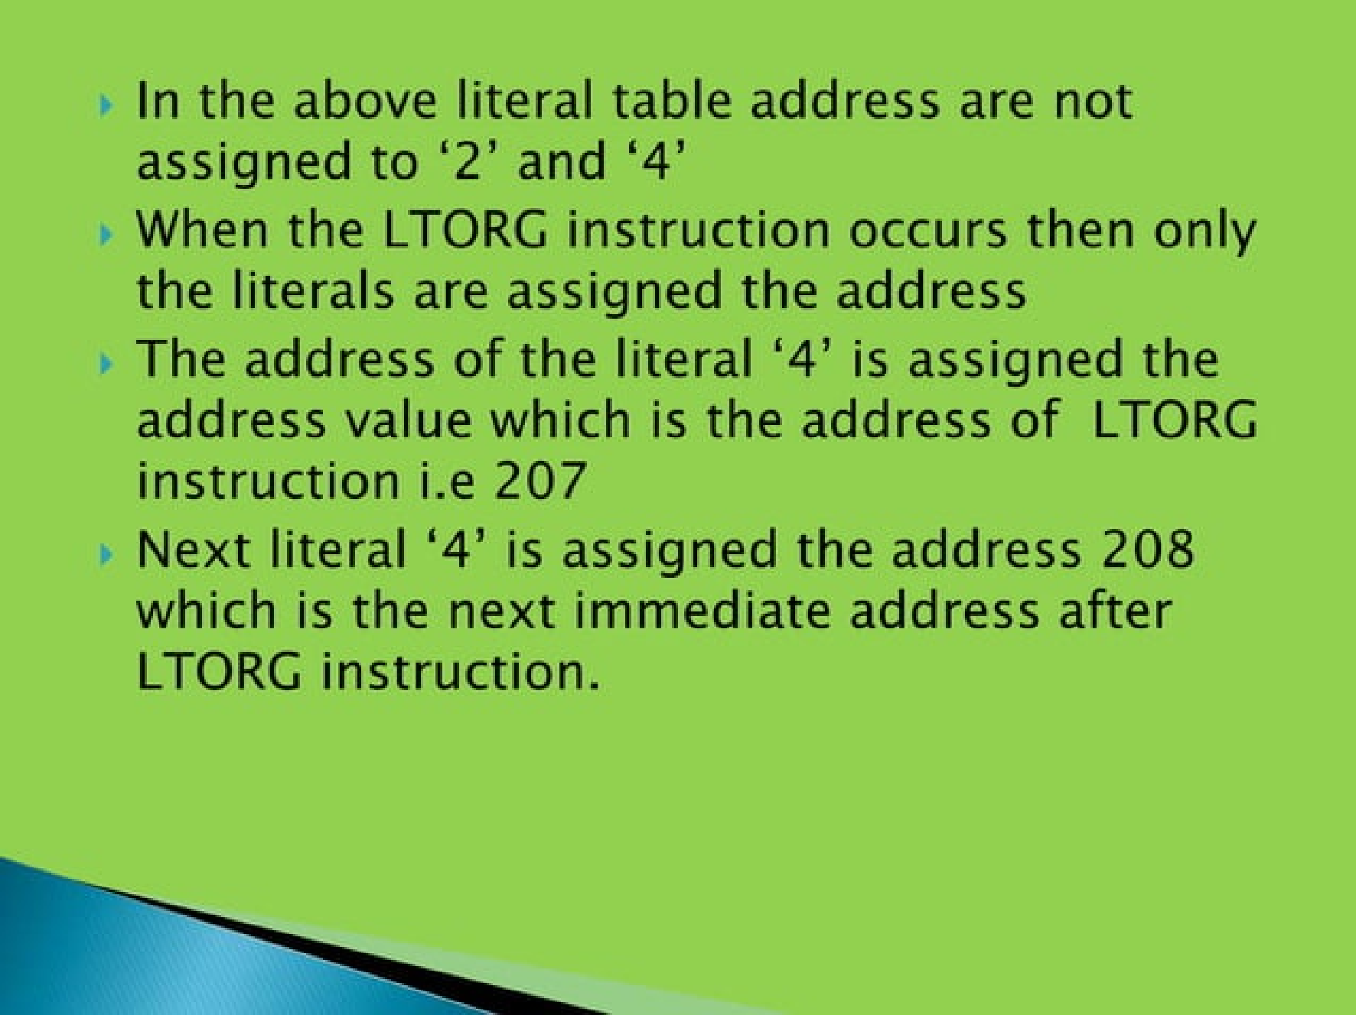

Slide 27
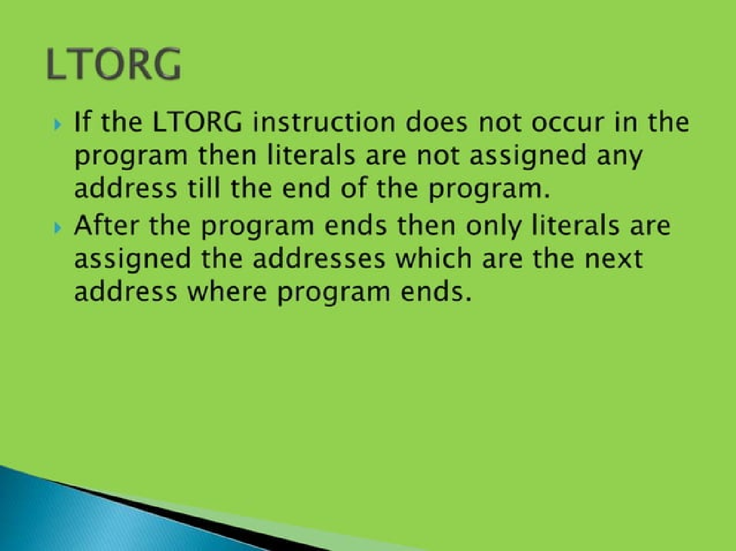

Slide 28
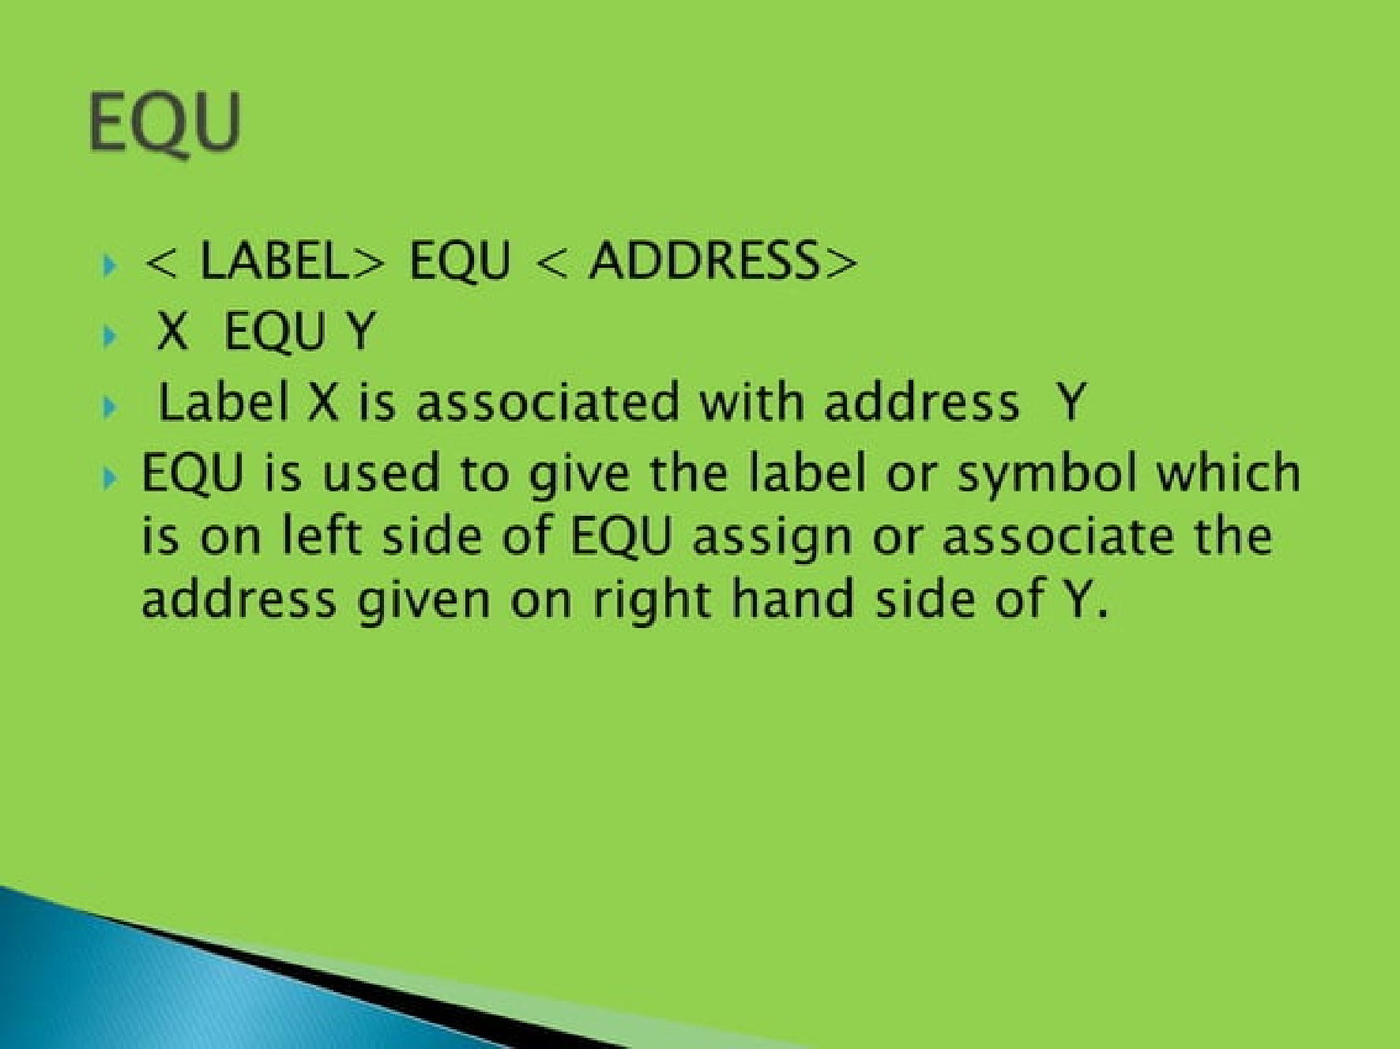

Slide 29
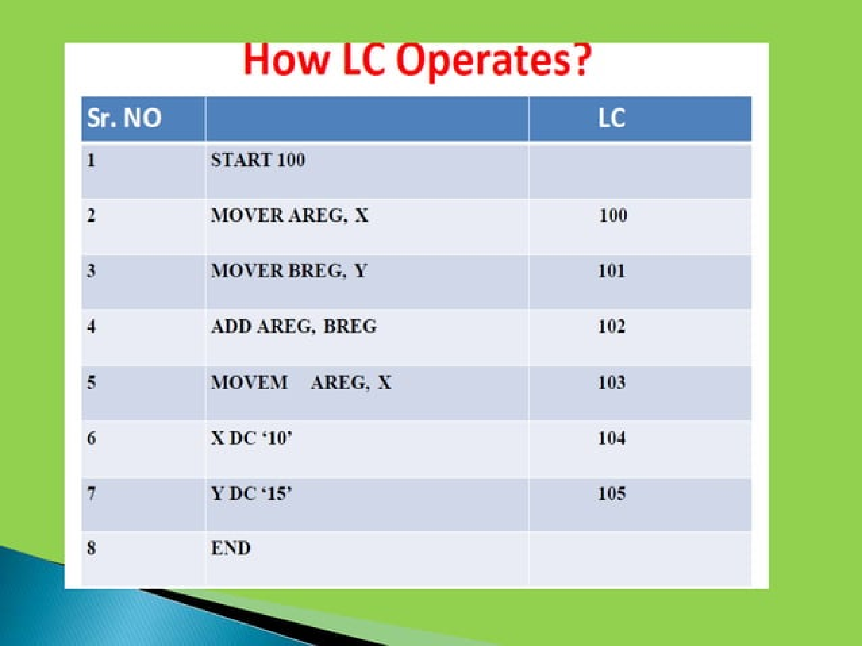

Slide 30
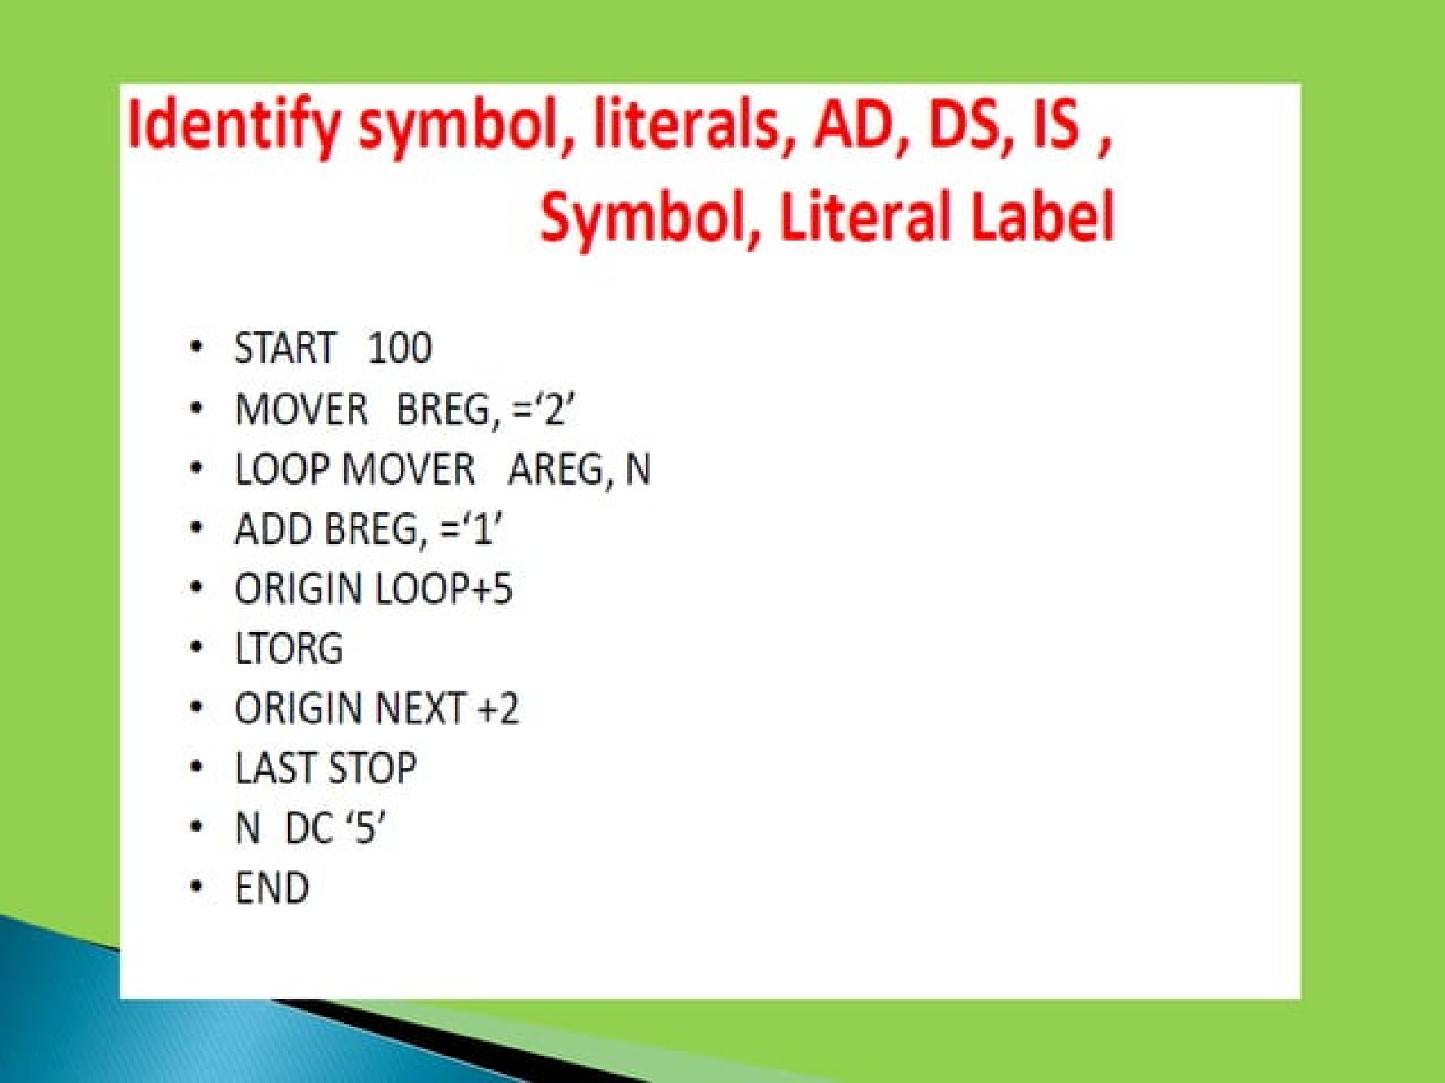

Slide 31
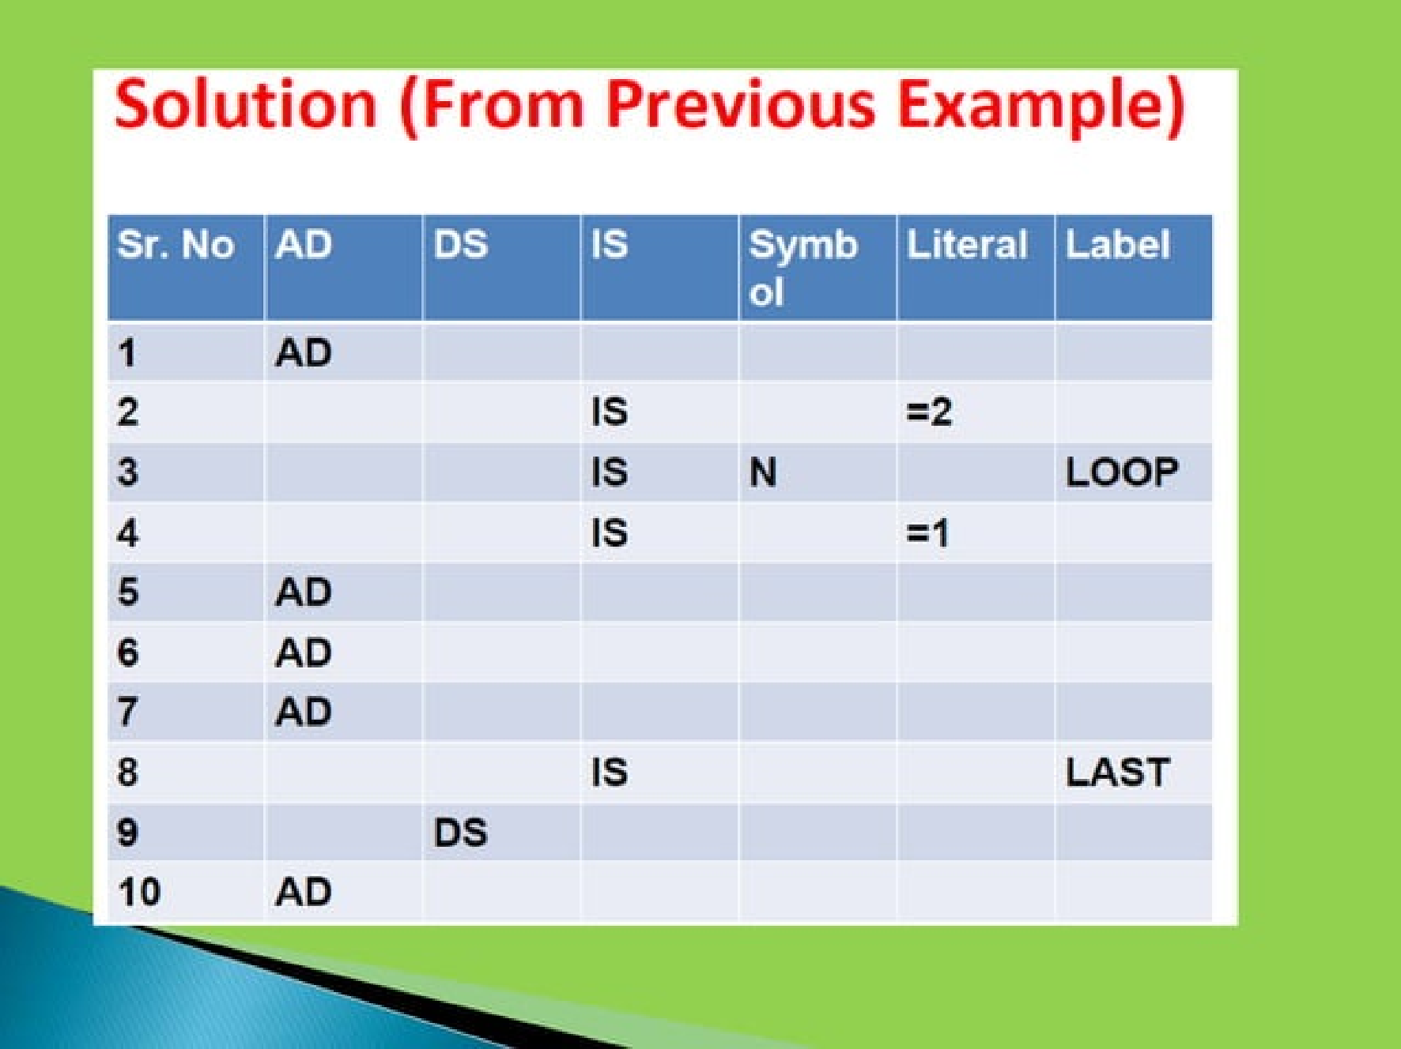

Slide 32
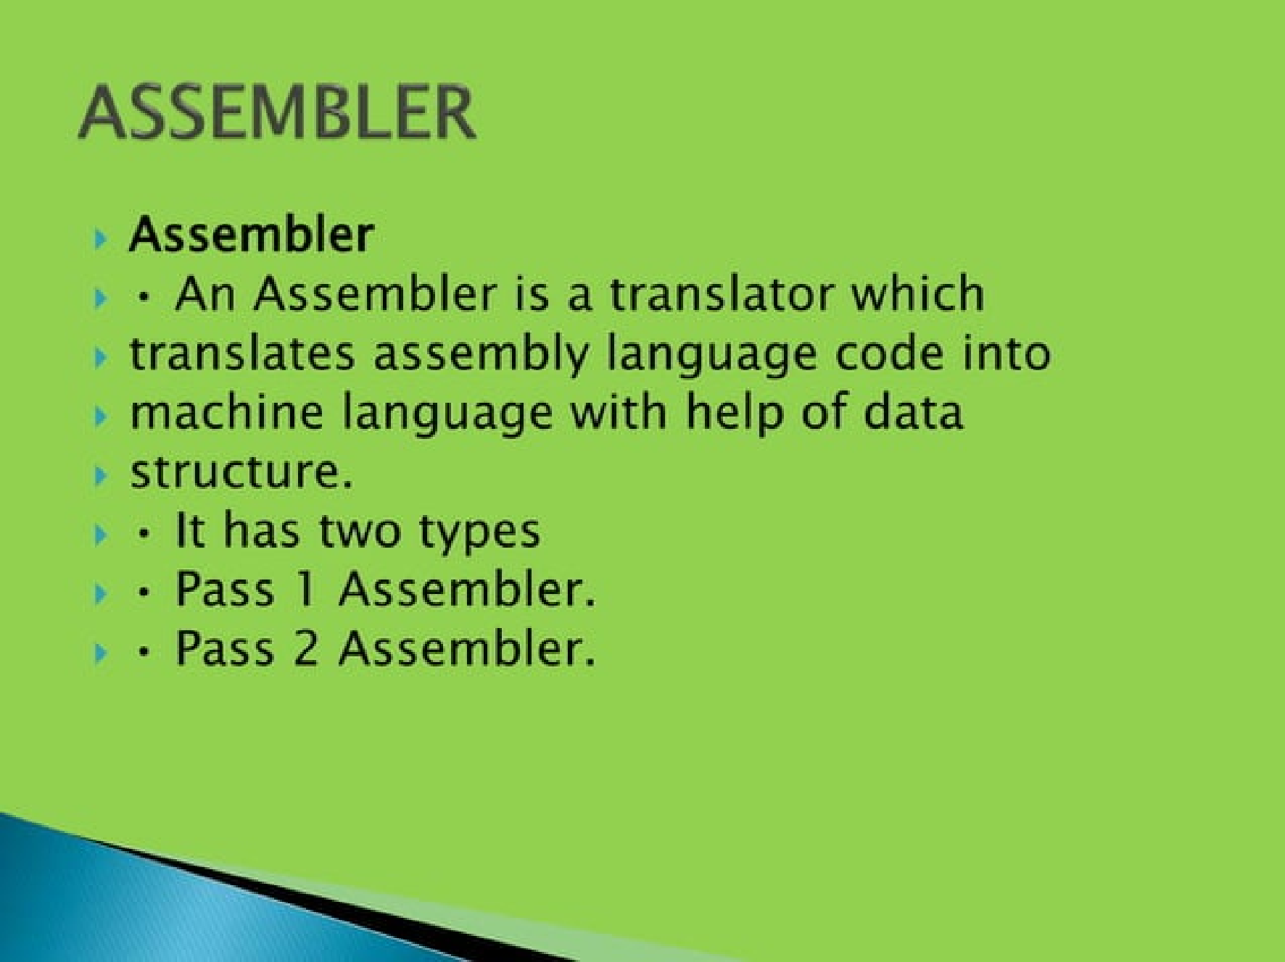

Slide 33
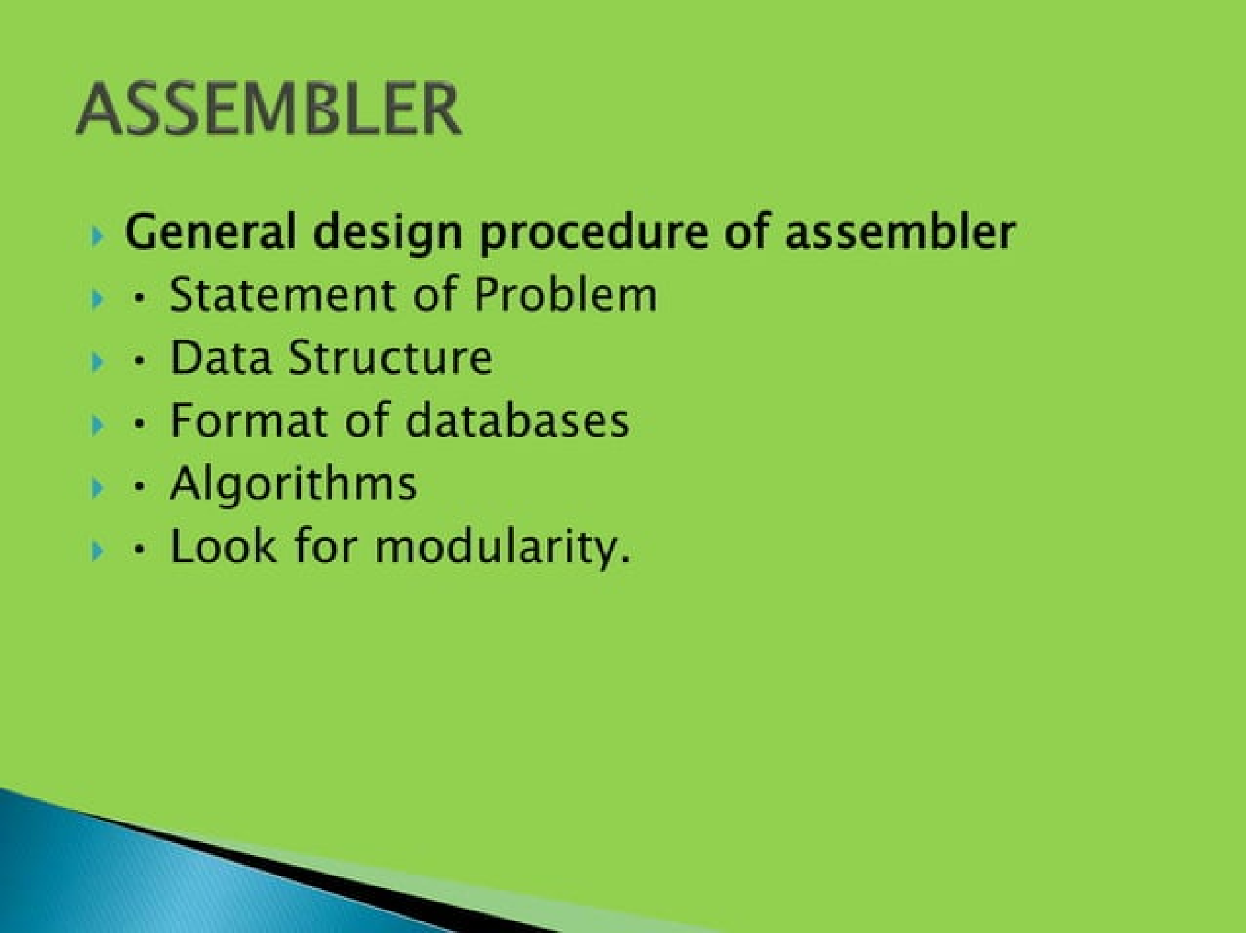

Slide 34
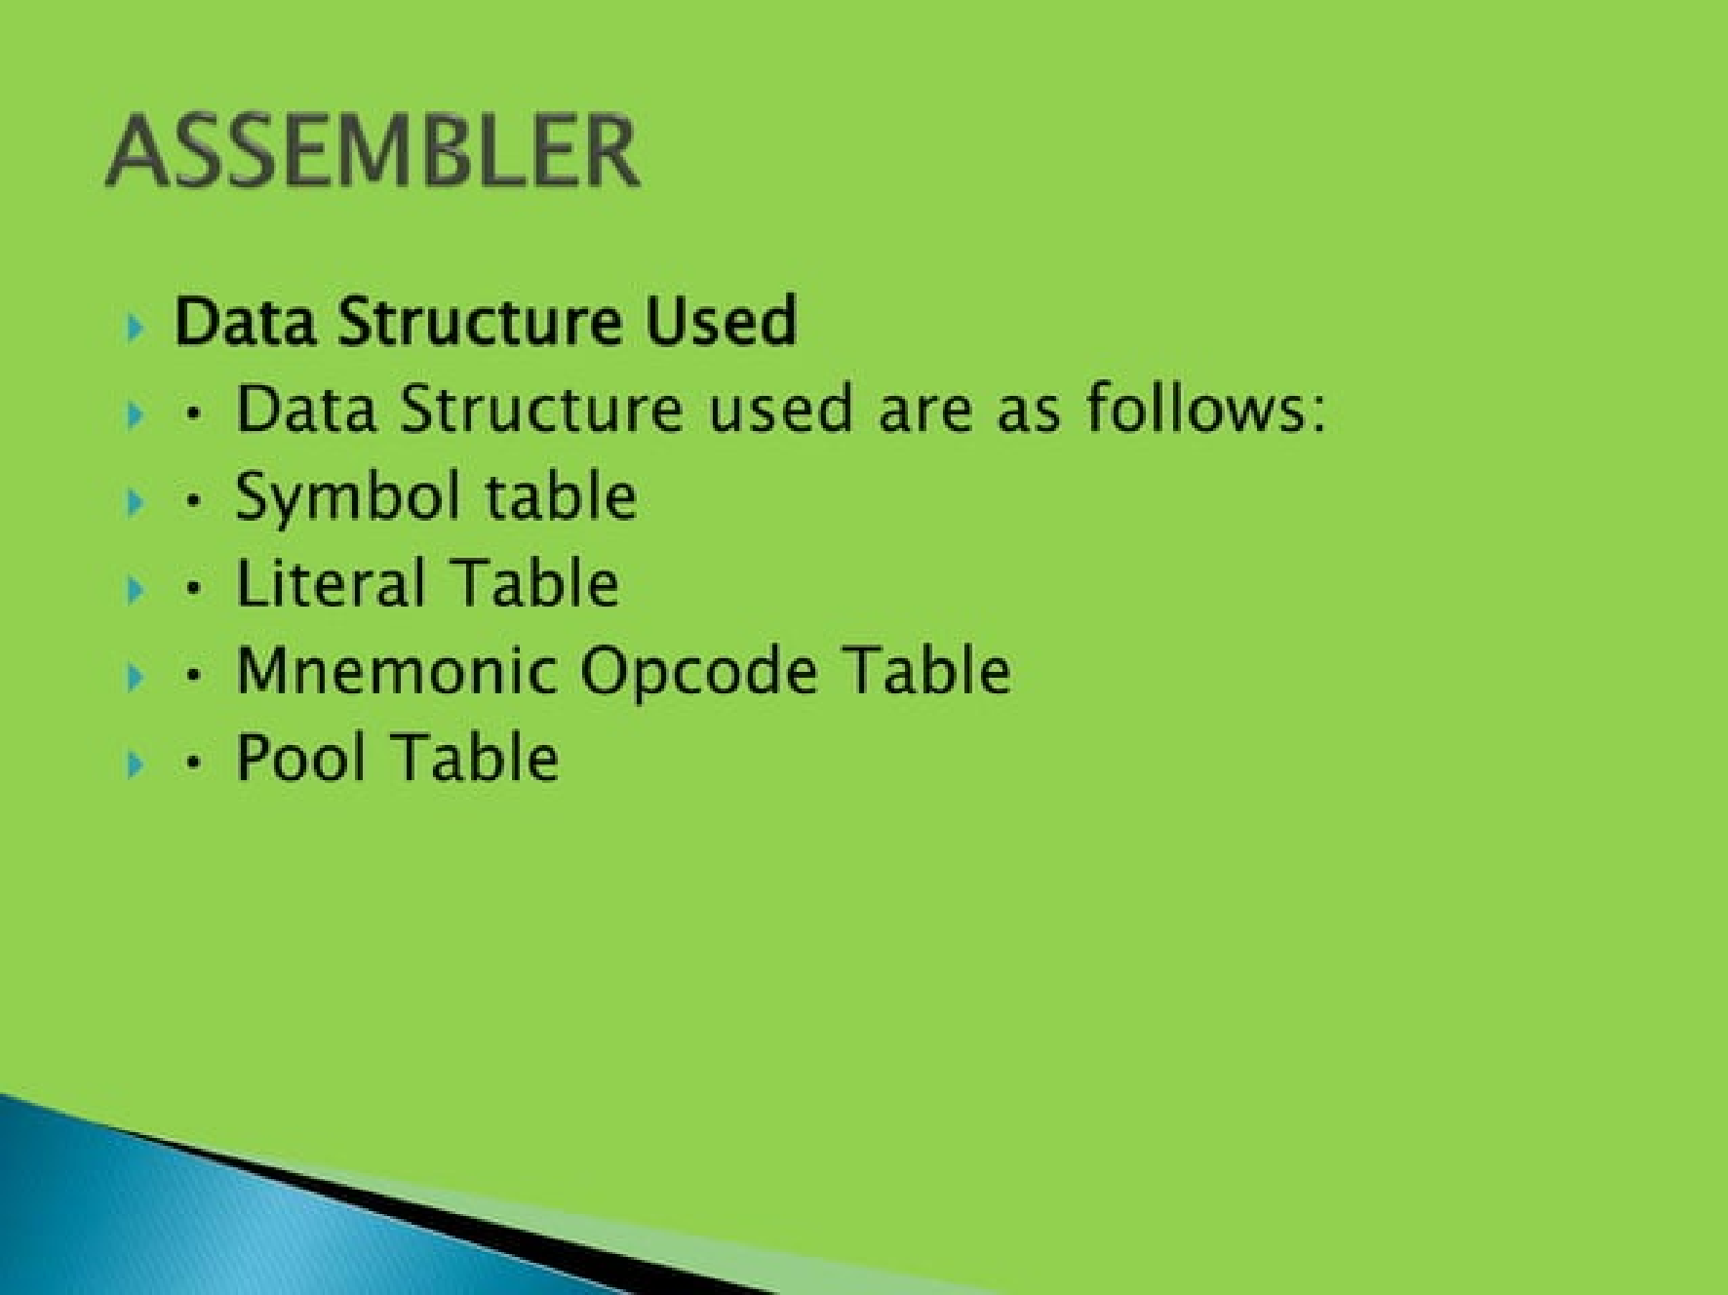

Slide 35
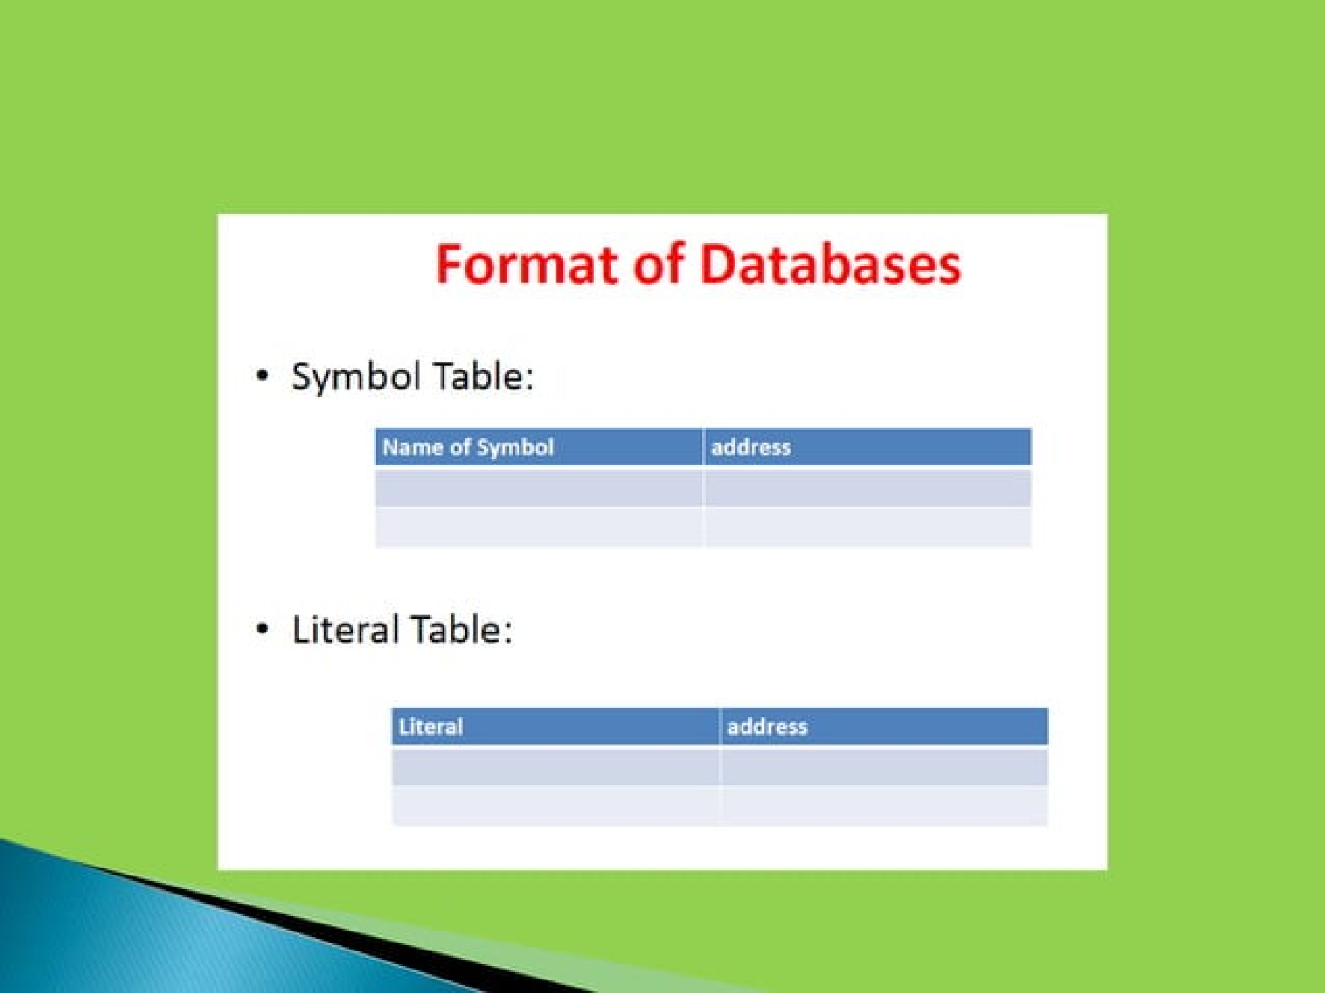

Slide 36
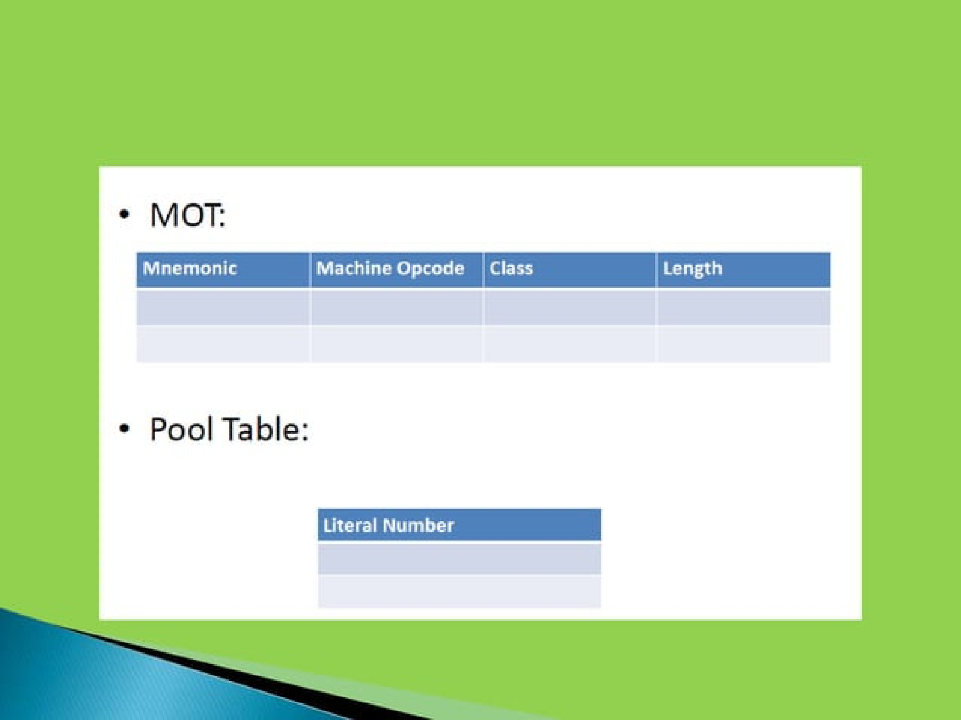

Slide 37
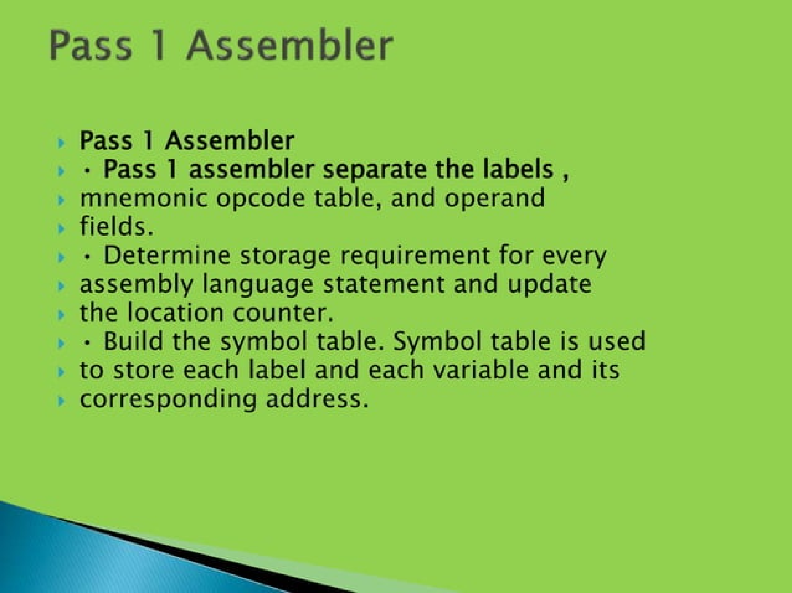

Slide 39
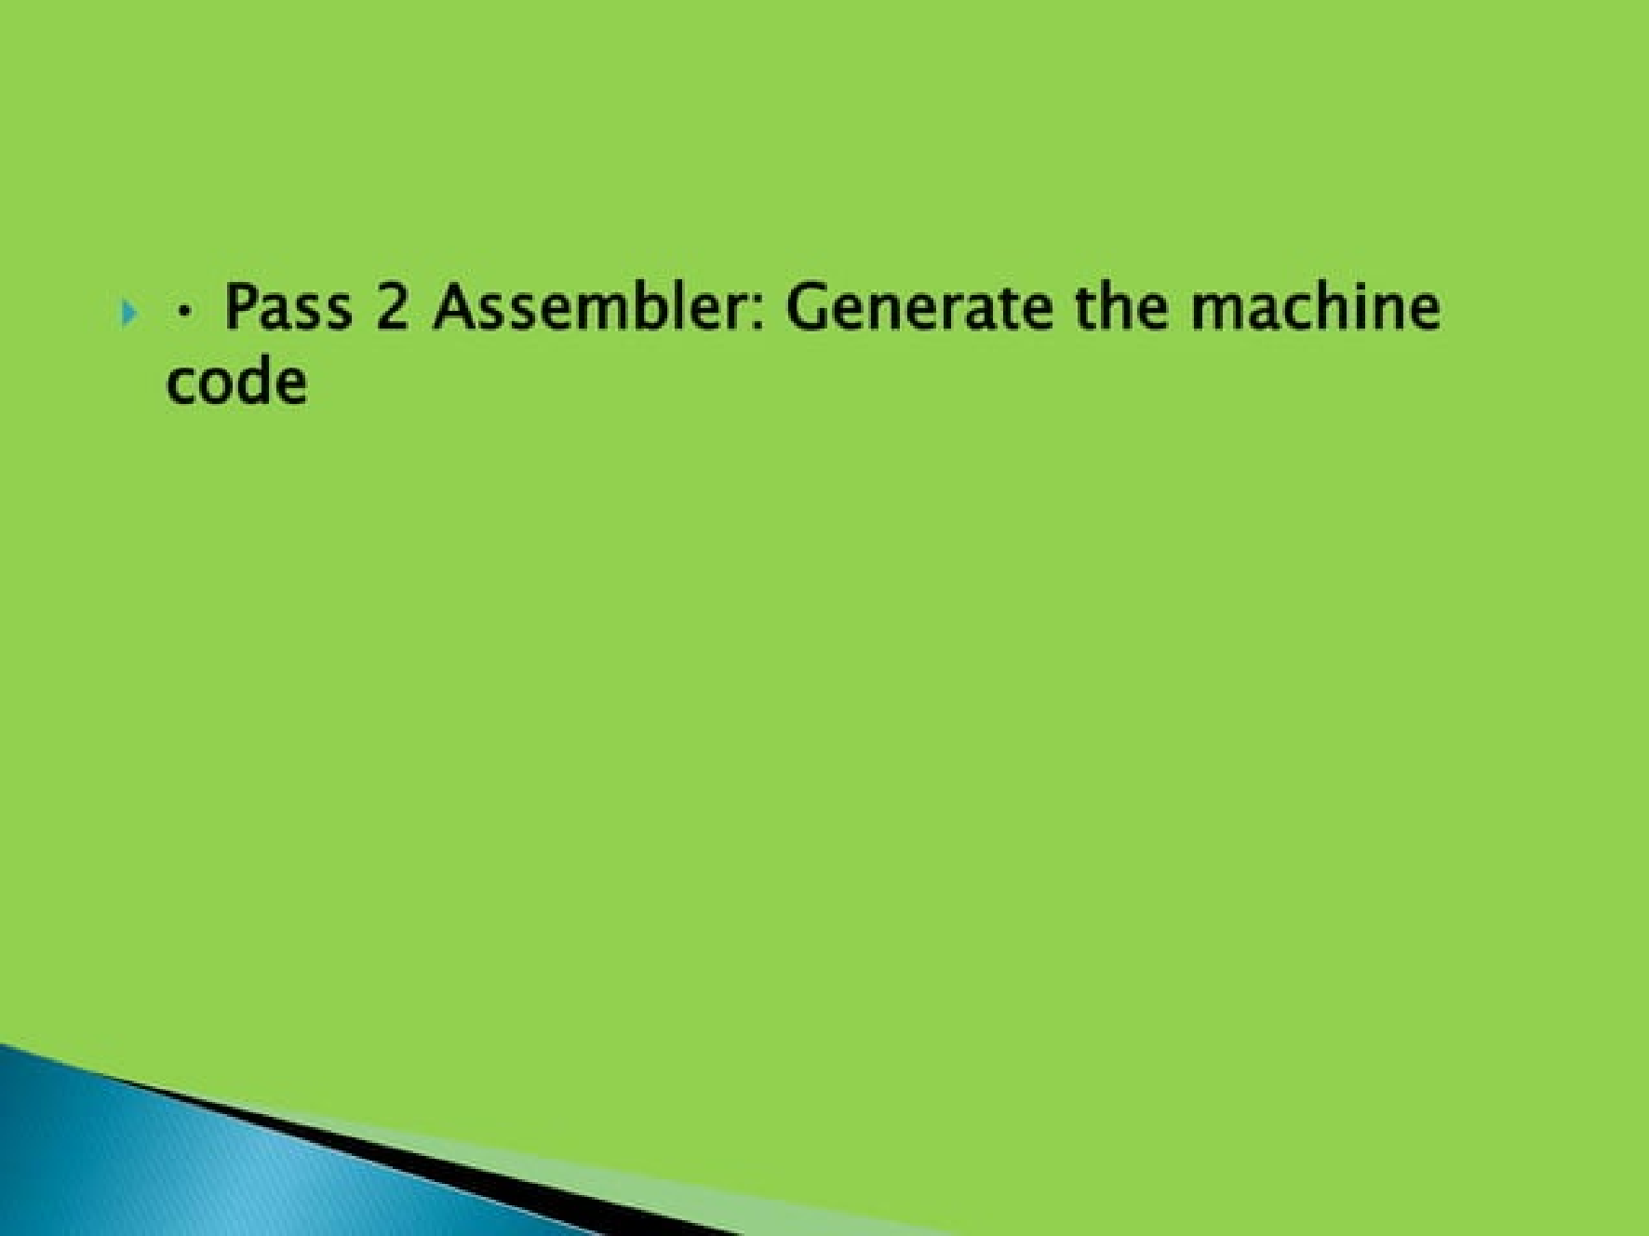

Slide 40
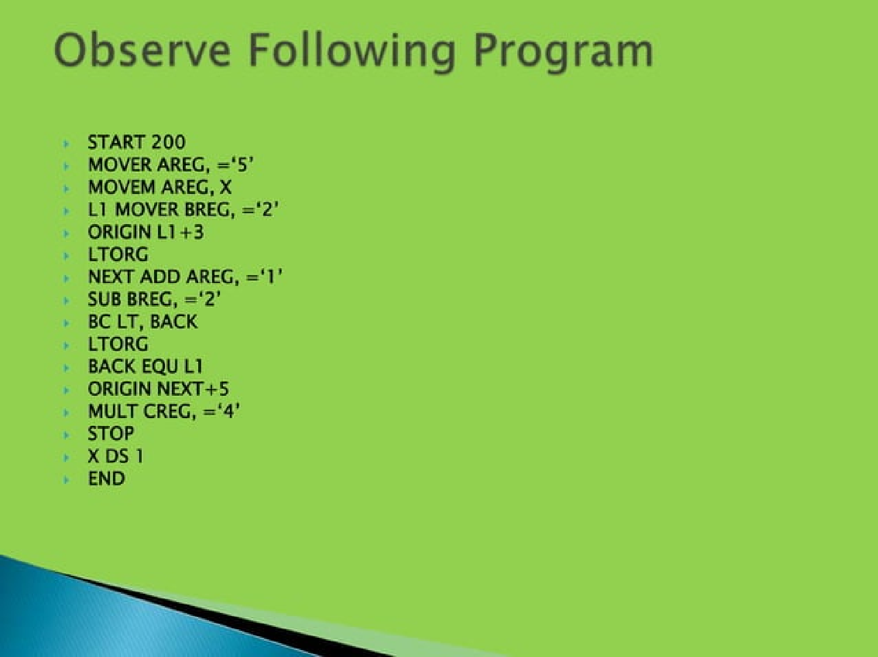

Slide 42
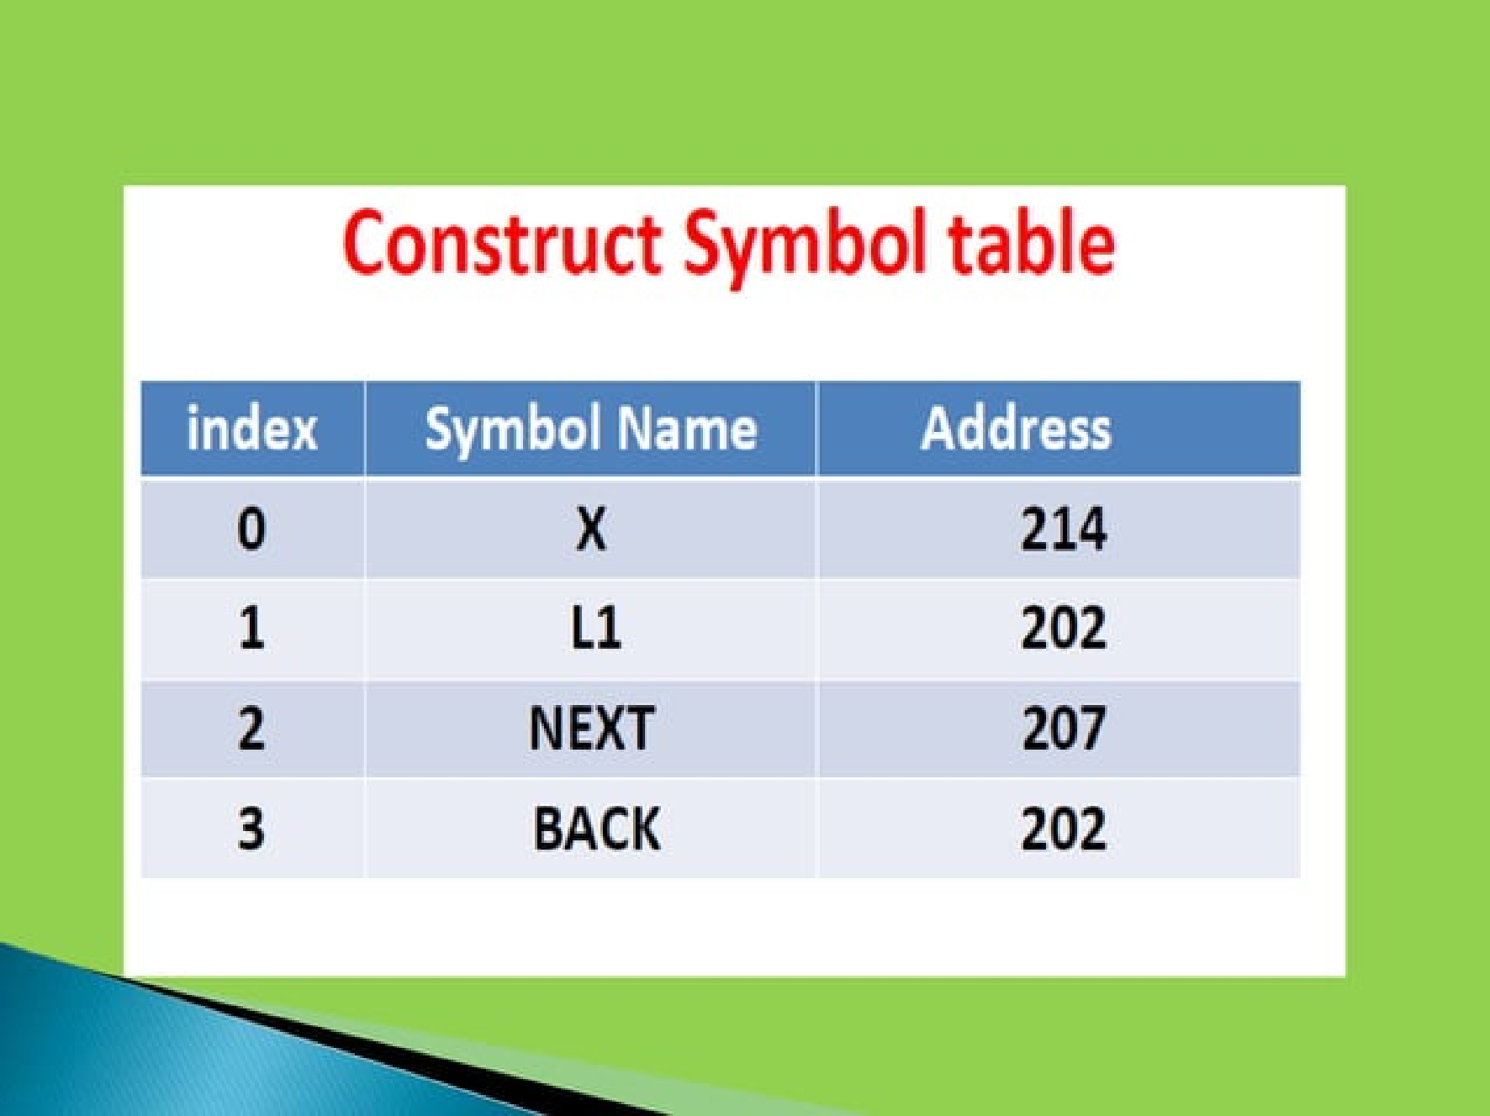

Slide 43
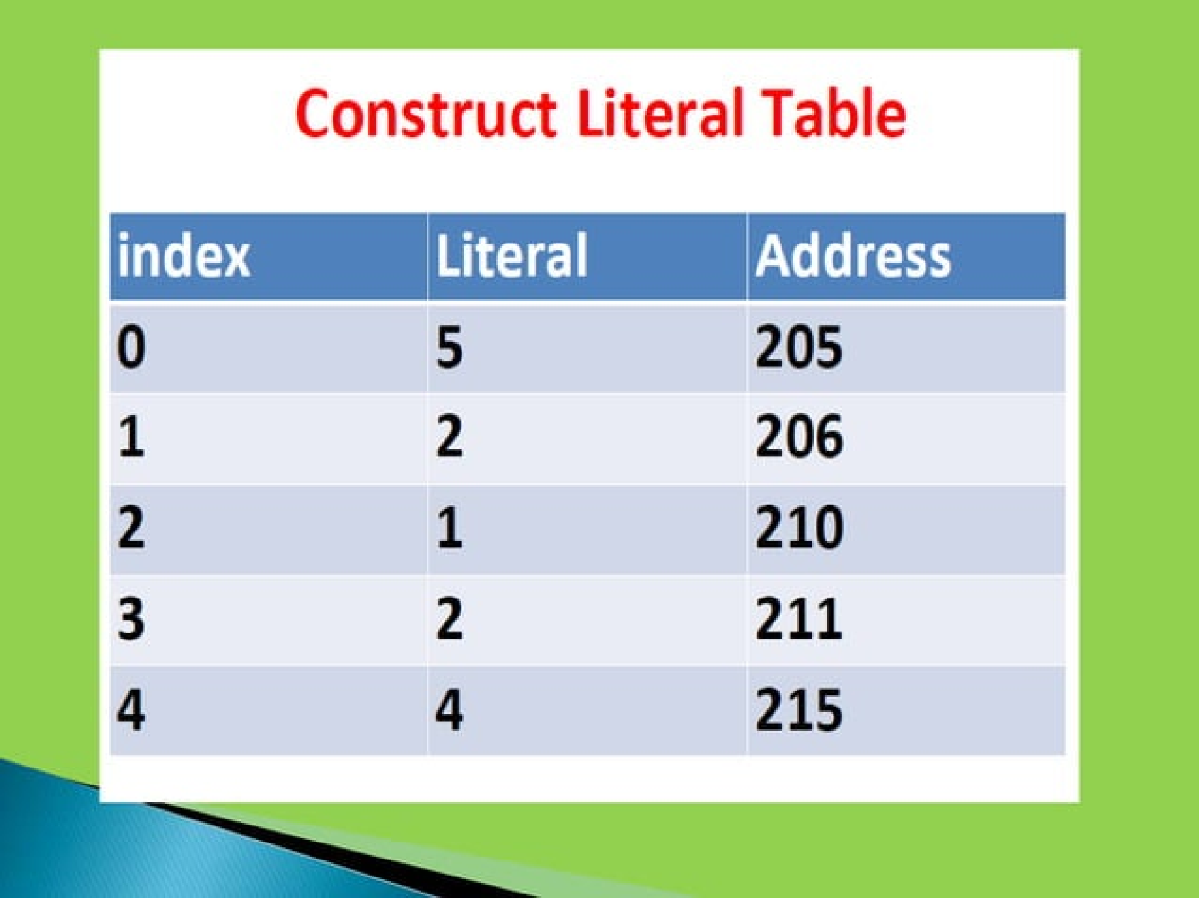

Slide 44
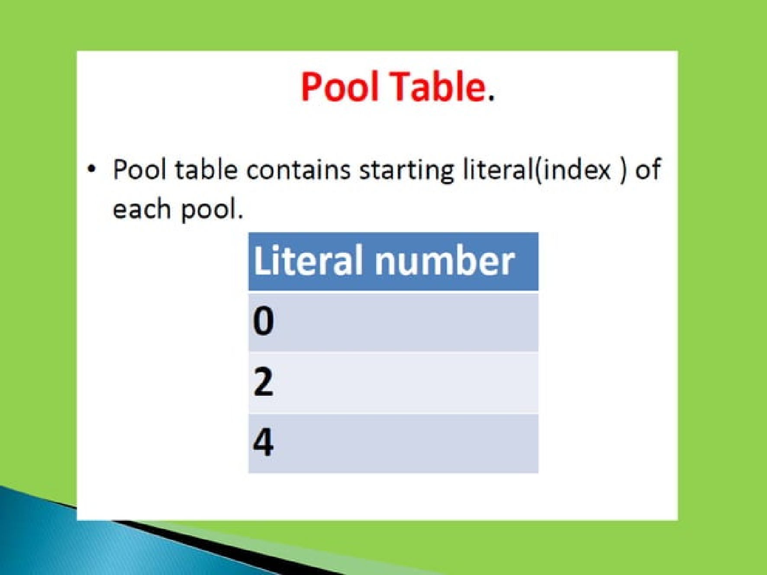

Slide 45
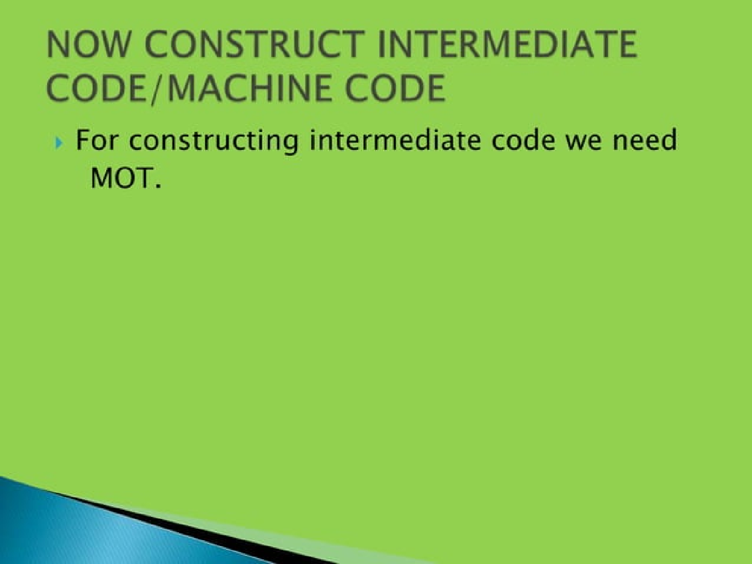

Slide 46
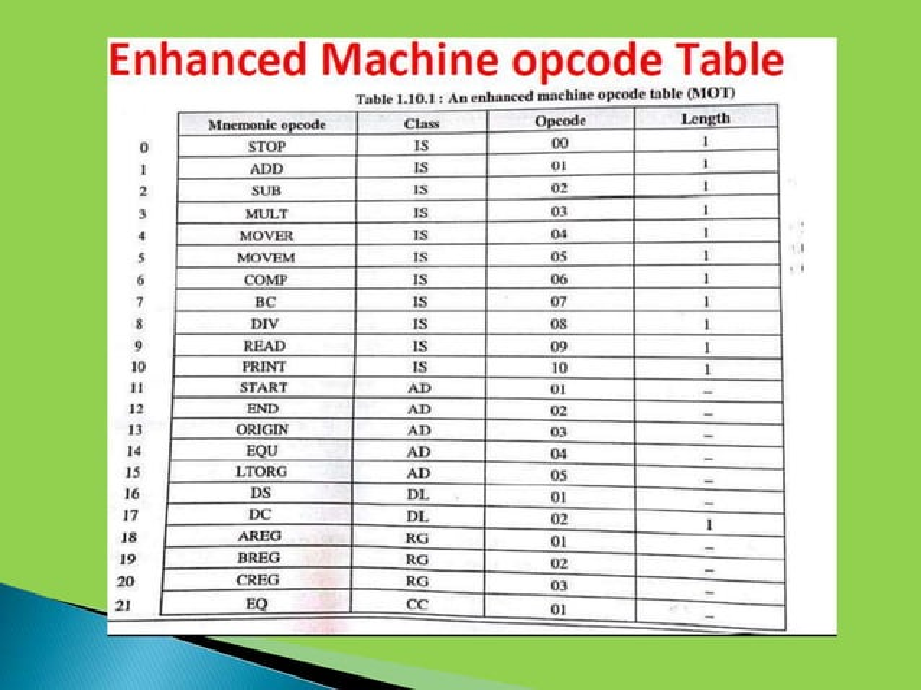

Slide 47
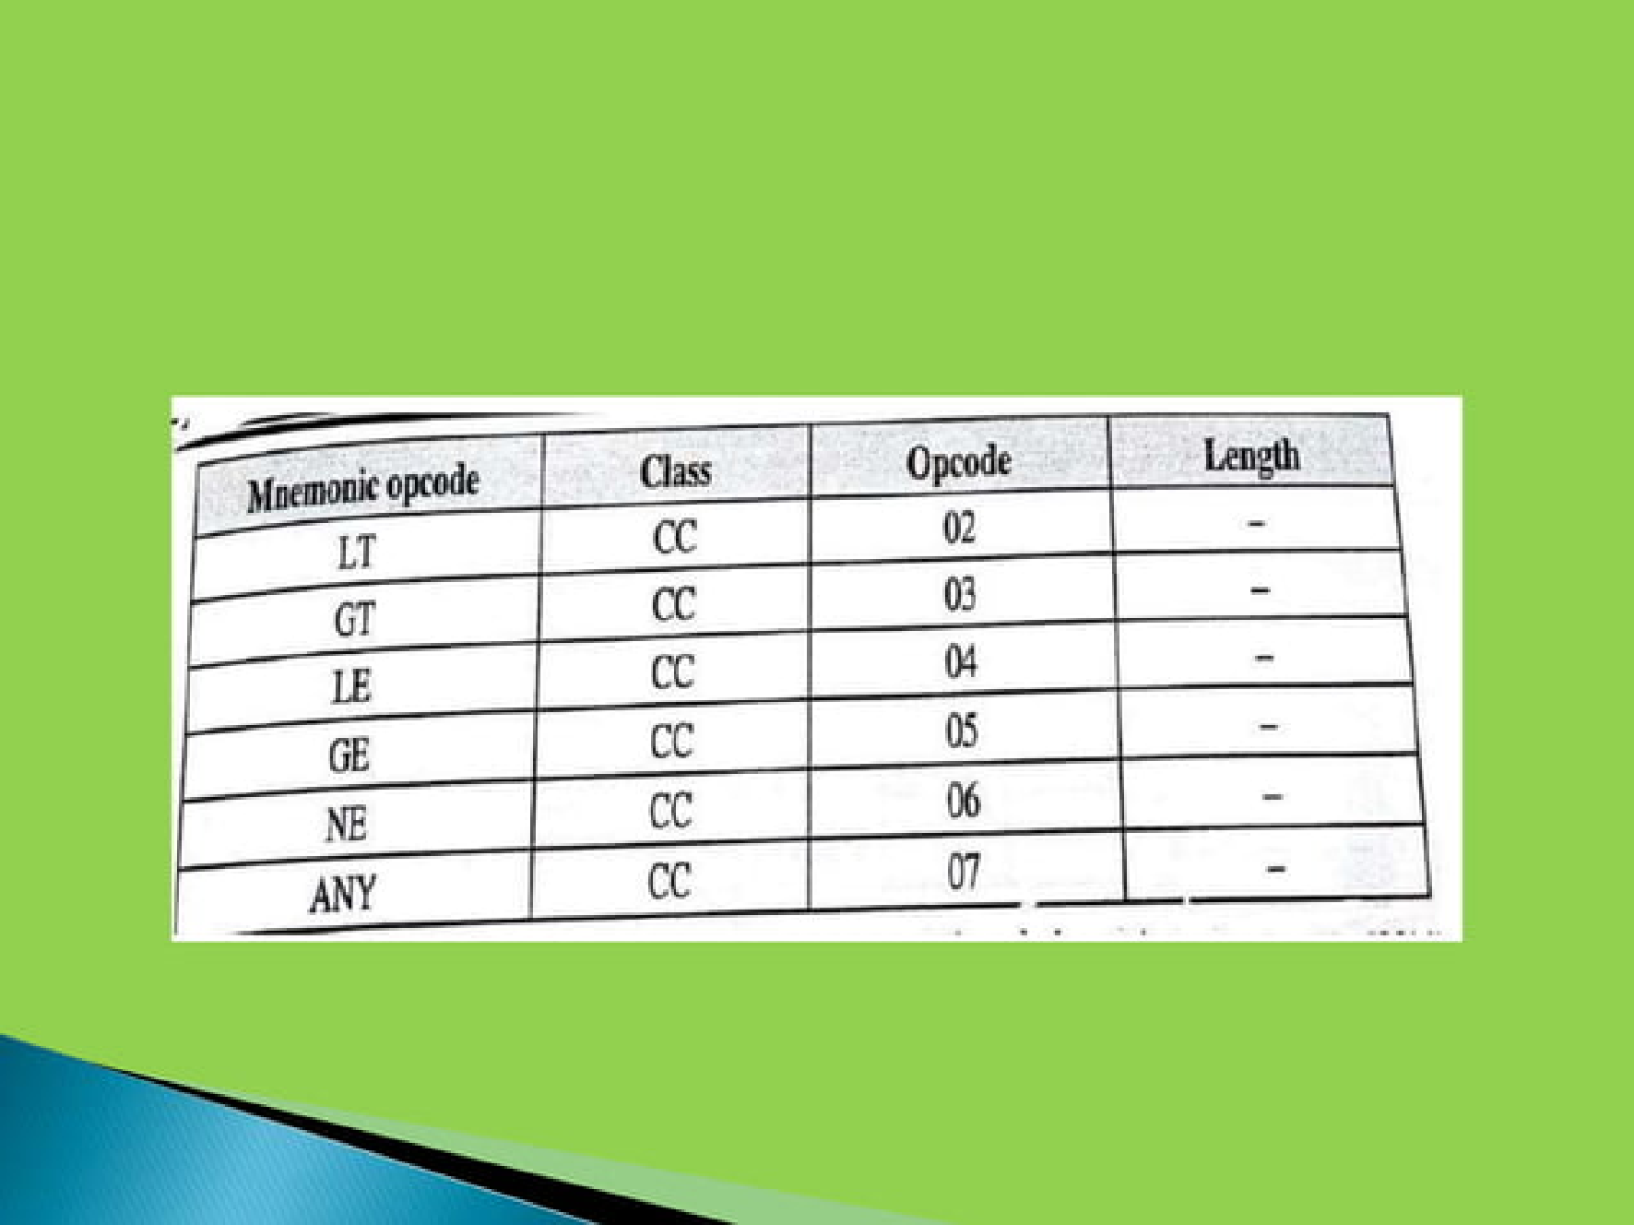

Slide 48
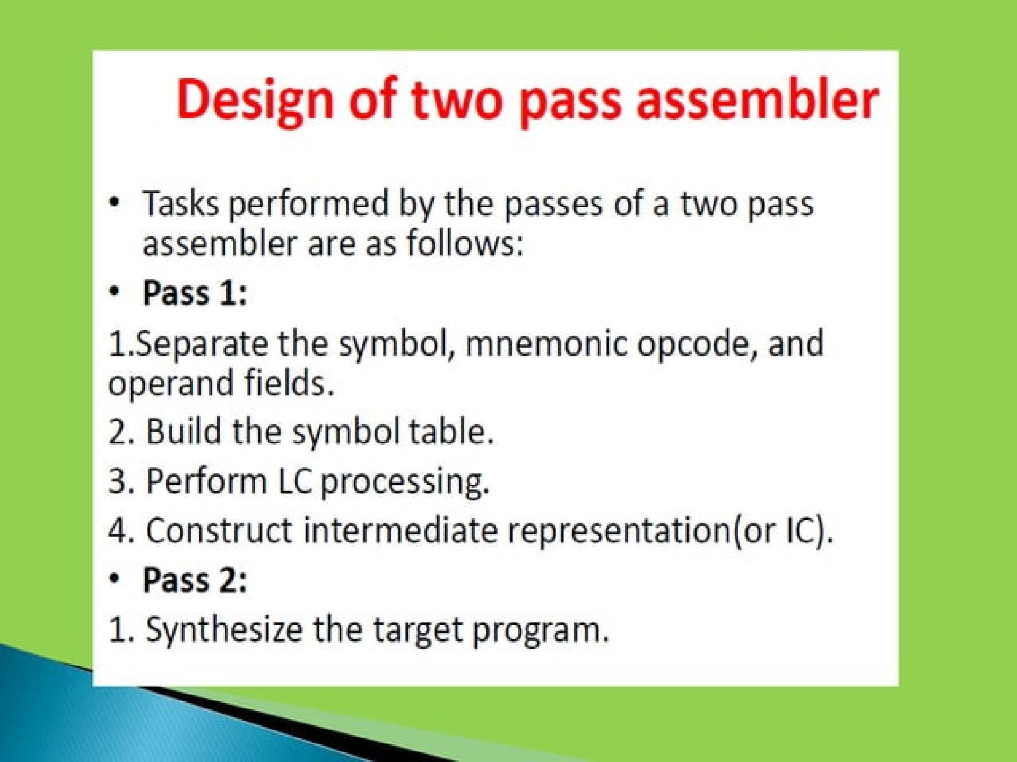

Slide 49
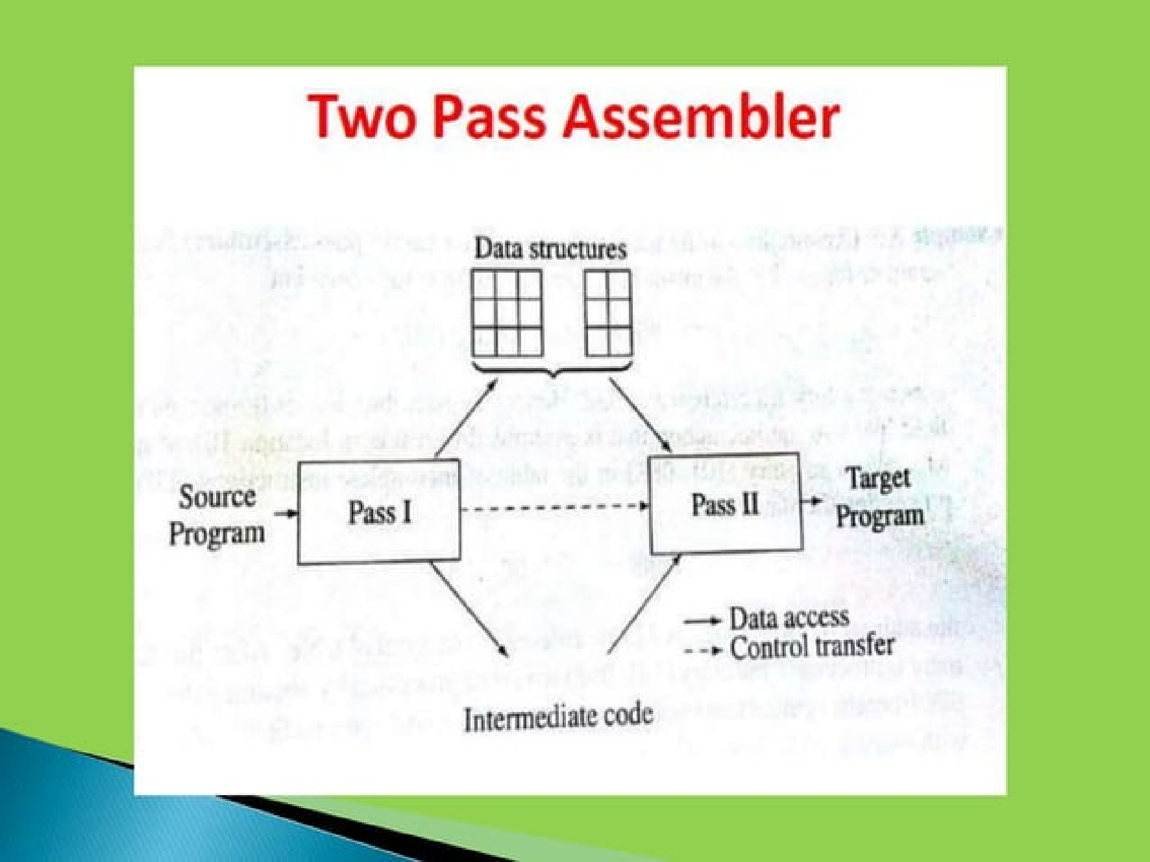

Slide 50
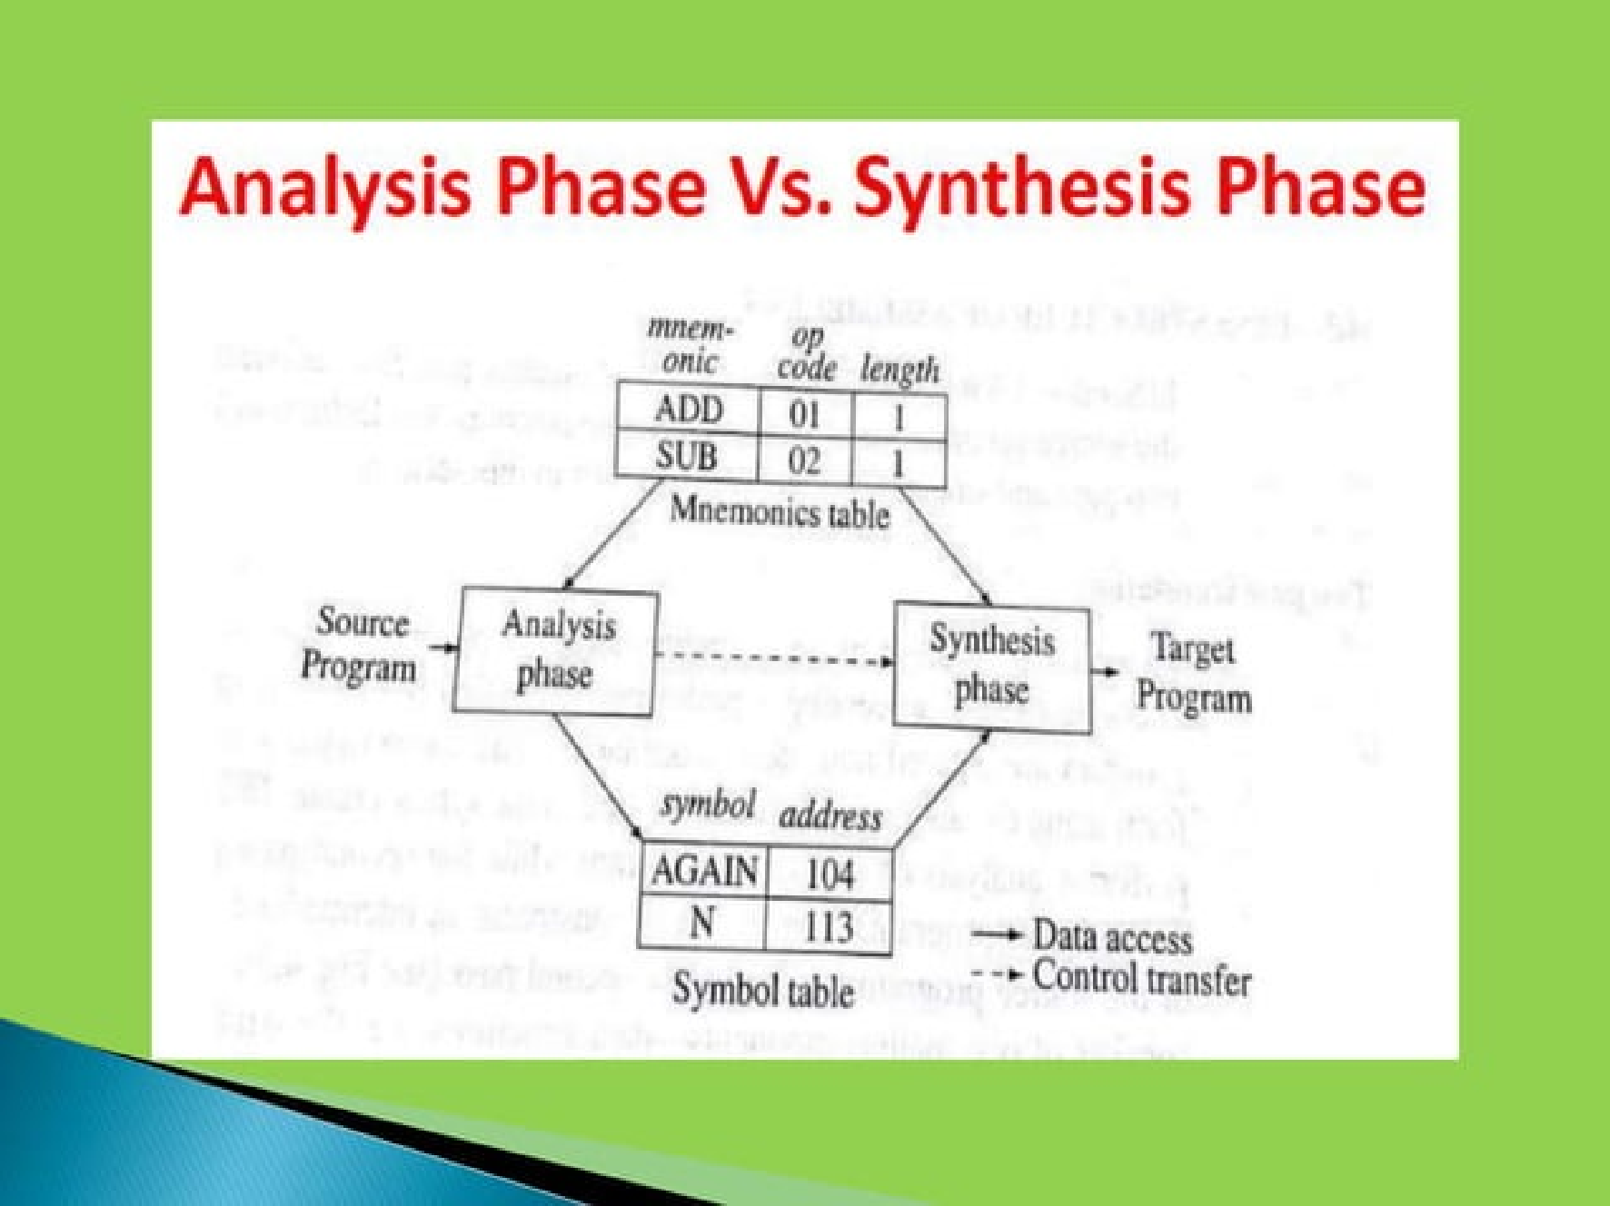

Slide 51
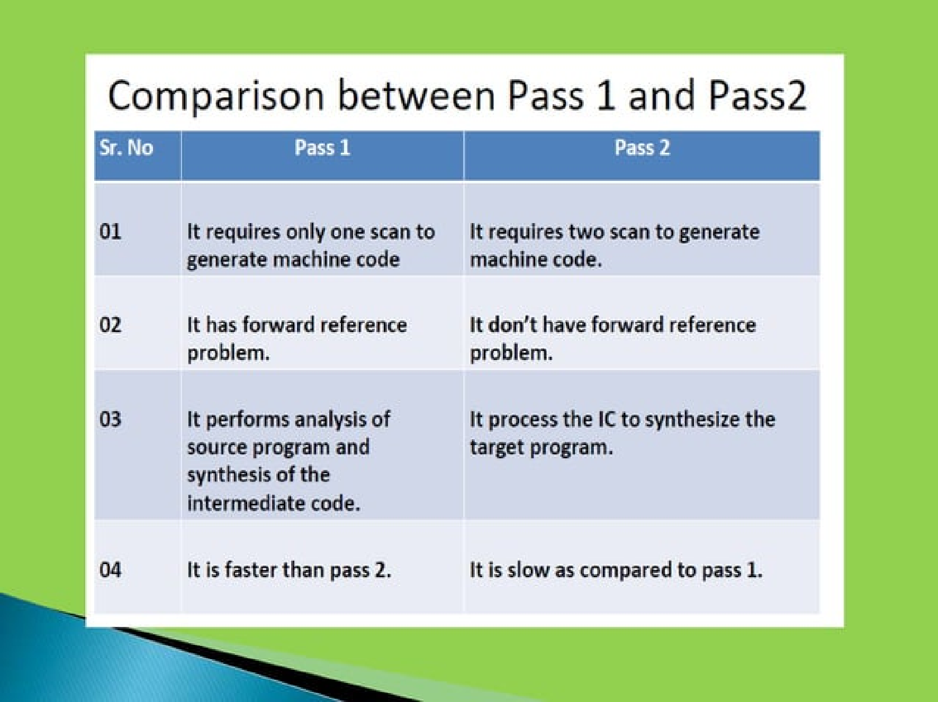

Slide 52
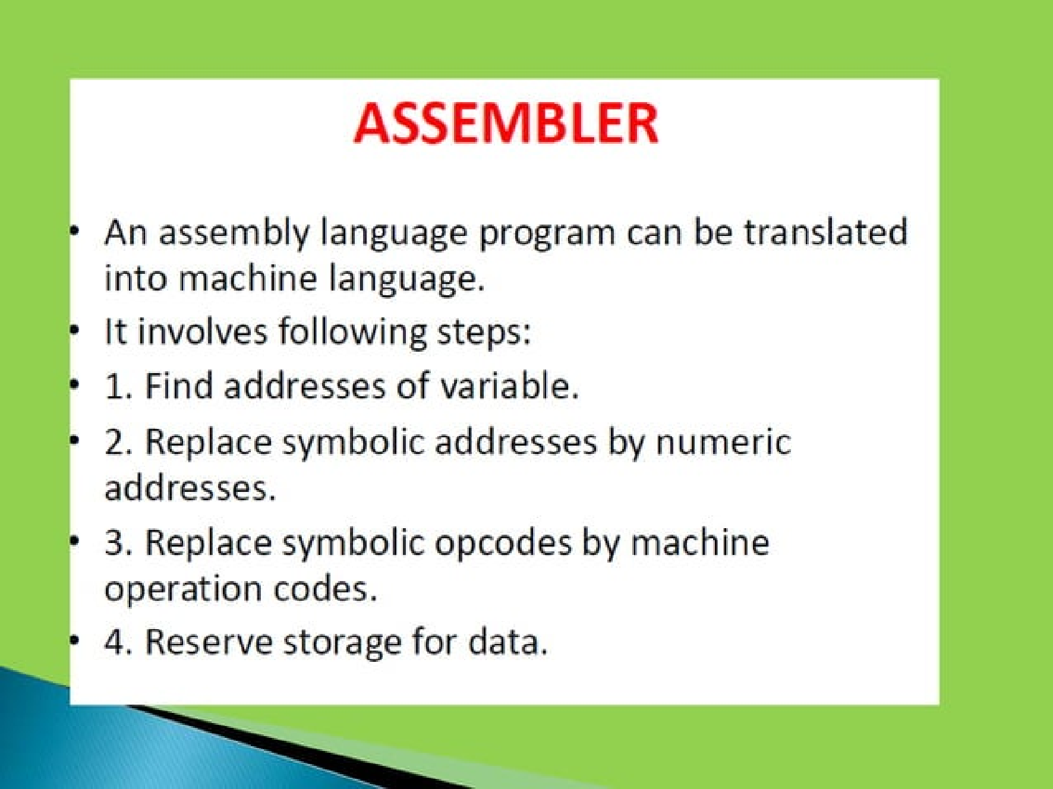

Slide 53
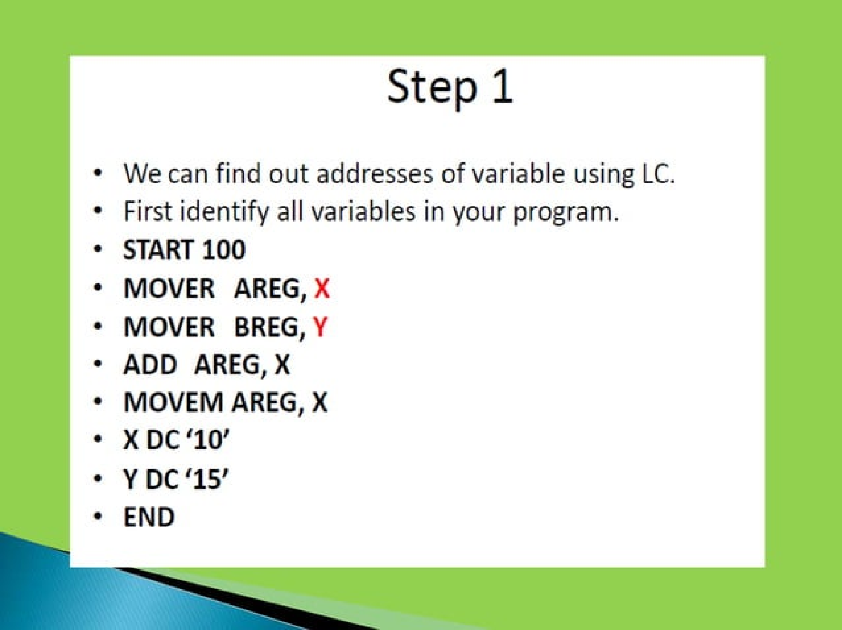

Slide 54
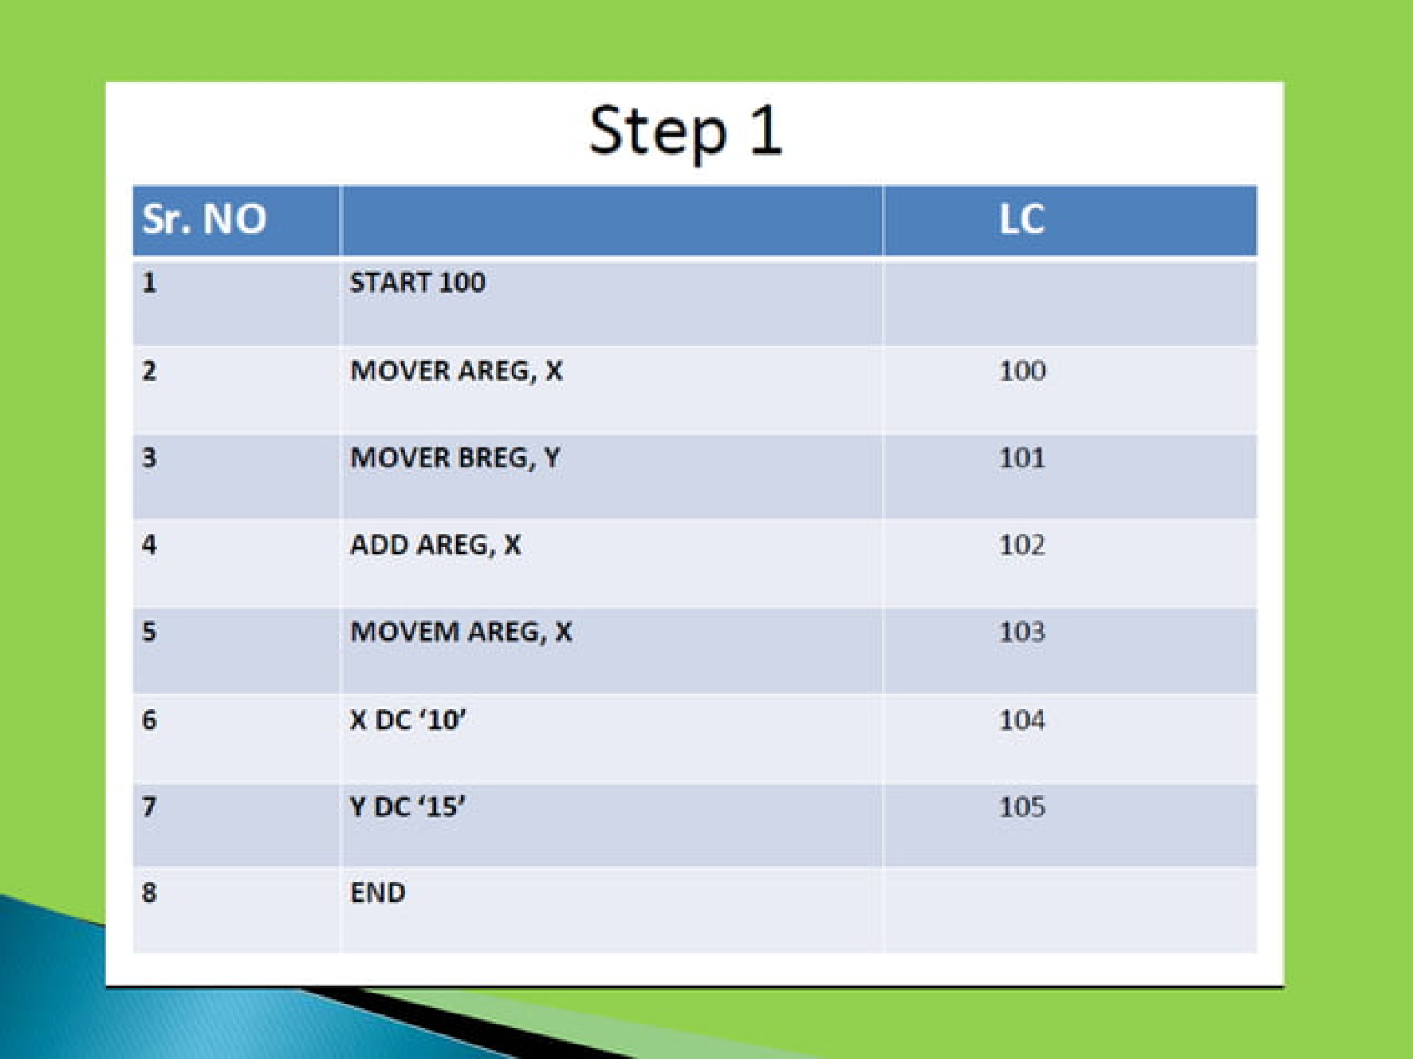

Slide 55
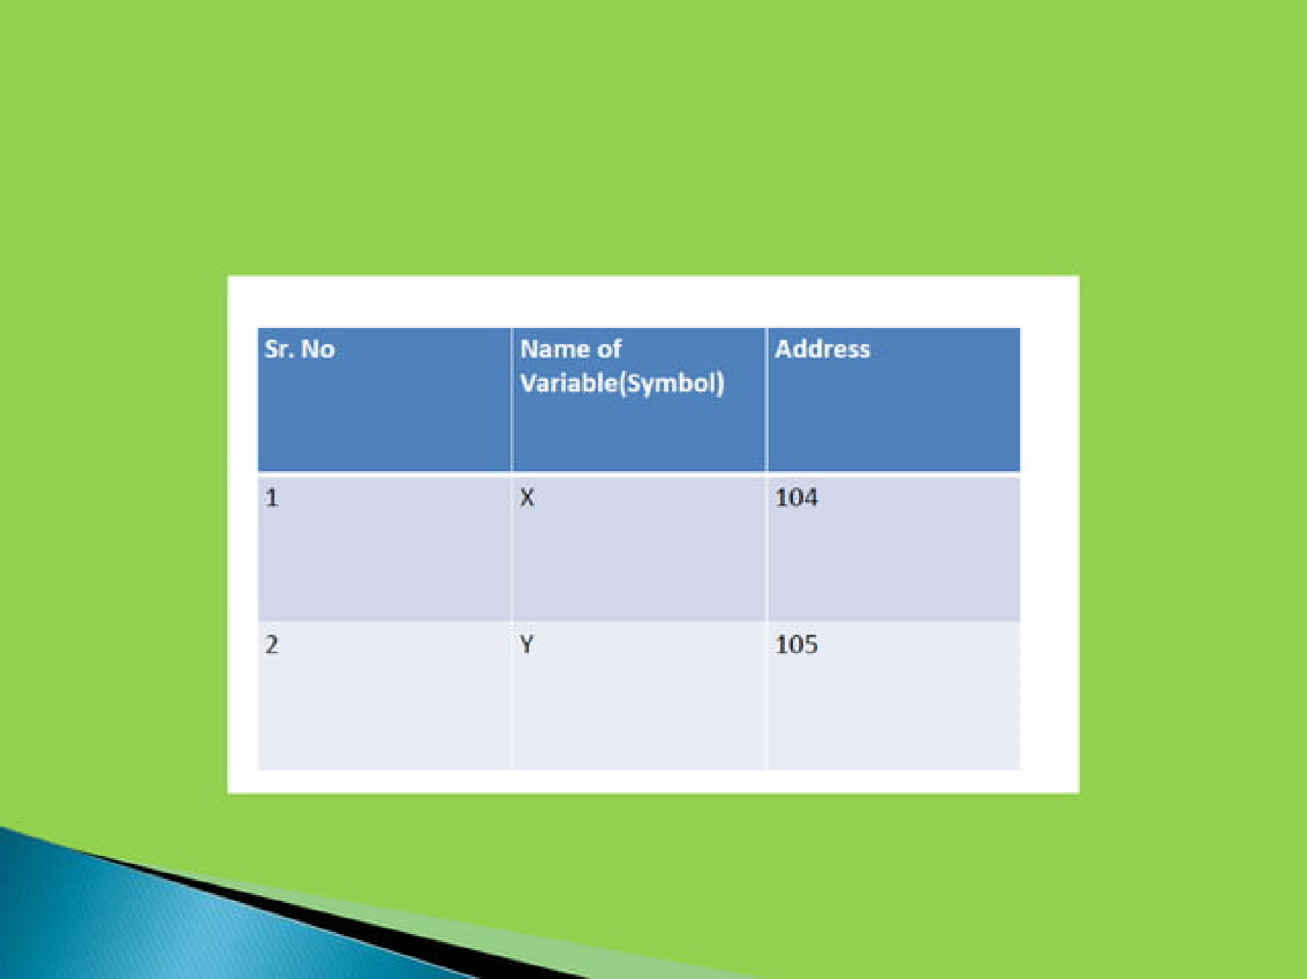

Slide 56
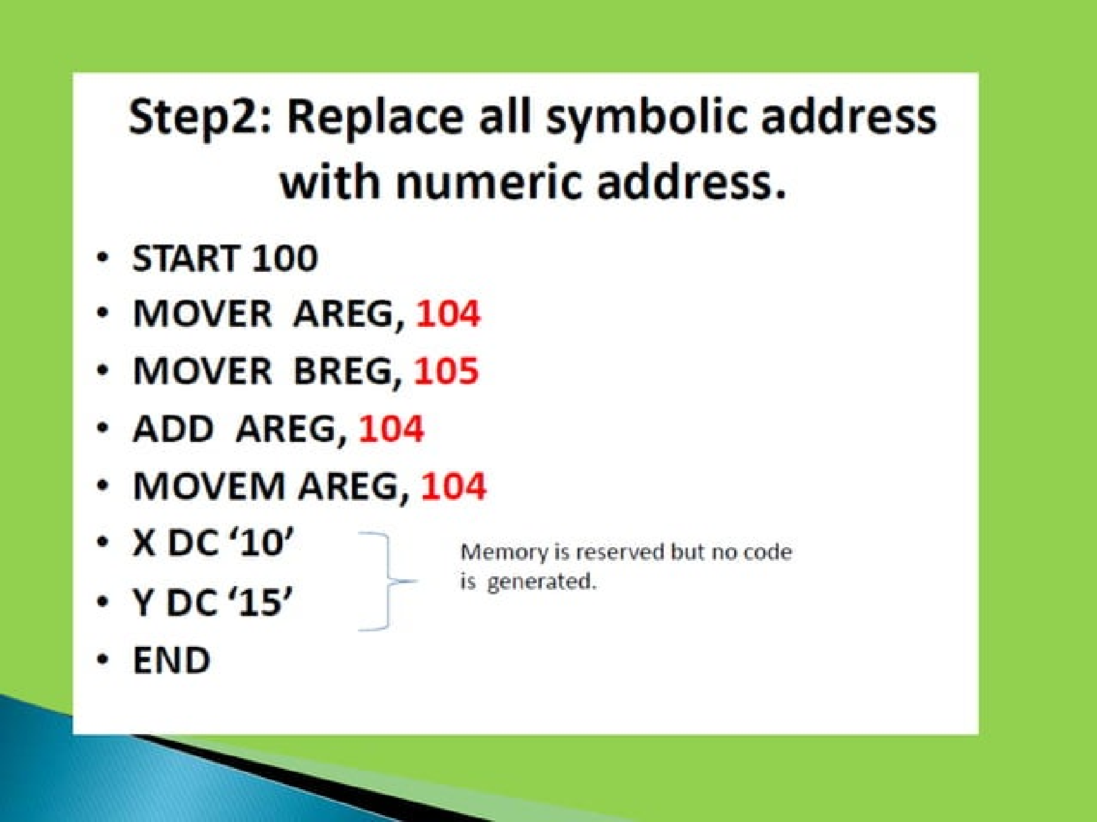

Slide 57


Slide 58


Slide 59


Slide 60


Slide 61


Slide 62


Slide 63


Slide 64


Slide 65


Slide 66


Slide 67


Slide 68
Single Pass Assembler
Forward reference: reference to a label that is defined later in the program.
Table of Incomplete Instruction
START | 200
ADD | AREG | A
.. | ..
A | DS | 2
.. | ..
END
What is Forward reference ??Eg..
Instruction Address | Symbol
200 | A
.. | ..

Slide 69
Single Pass Assembler
Forward reference: reference to a label that is defined later in the program.
Table of Incomplete Instruction
START | 200
ADD | AREG | A
.. | ..
A | DS | 2
.. | ..
END
Symbol | Address
A
Instruction Address | Symbol
200 | A
.. | ..

Slide 70
Single Pass Assembler
Forward reference: reference to a label that is defined later in the program.
Table of Incomplete Instruction
START | 200
ADD | AREG | A
.. | ..
A | DS | 2
.. | ..
END
Target Code
200 | 01 | 01 | -
… | .. | .. | ..
202
Target Code
200 | 01 | 01 | 202
.. | .. | .. | ..
202
Instruction Address | Symbol
200 | A
.. | ..
Symbol | Address
A | 202
.. | ..

Slide 71
Single pass Assembler Examples
SOURCE PROGRAM
 | START | 101
 | READ | N
 | MOVER | BREG, | ONE
 | MOVEM | BREG, | TERM
AGAIN | MULT | BREG, | TERM
 | MOVER | CREG, | TERM
 | ADD | CREG, | ONE
 | MOVEM | CREG, | TERM
 | COMP | CREG, | TERM
 | BC | LE, | AGAIN
 | MOVEM | BREG, | RESULT
 | PRINT | RESULT
 | STOP
N | DS | 1
RESULT | DS | 1
ONE | DC | ‘1’
TERM | DS | 1
 | END
TARGET CODE
101 | 09 | -
102 | 04 | 02 | -
103 | 05 | 02 | -
104 | 03 | 02 | -
105 | 04 | 03 | -
106 | 01 | 03 | -
107 | 05 | 03 | -
108 | 06 | 03 | -
109 | 07 | 02 | 104
110 | 05 | 02 | -
111 | 10 | -
112 | 00
113
114
115
116
TII
INSTRUCTION Address | SYMBOL
101 | N
102 | ONE
103 | TERM
104 | TERM
105 | TERM
106 | ONE
107 | TERM
108 | TERM
110 | RESULT
111 | RESULT
Symbol Table
SYMBOL | ADDRESS
N | 113
ONE | 115
TERM | 116
RESULT | 114

Slide 72
Single pass Assembler Examples
SOURCE PROGRAM
 | START | 101
 | READ | N
 | MOVER | BREG, | ONE
 | MOVEM | BREG, | TERM
AGAIN | MULT | BREG, | TERM
 | MOVER | CREG, | TERM
 | ADD | CREG, | ONE
 | MOVEM | CREG, | TERM
 | COMP | CREG, | TERM
 | BC | LE, | AGAIN
 | MOVEM | BREG, | RESULT
 | PRINT | RESULT
 | STOP
N | DS | 1
RESULT | DS | 1
ONE | DC | ‘1’
TERM | DS | 1
 | END
TARGET CODE
101 | 09 | 113
102 | 04 | 02 | 115
103 | 05 | 02 | 116
104 | 03 | 02 | 116
105 | 04 | 03 | 116
106 | 01 | 03 | 115
107 | 05 | 03 | 116
108 | 06 | 03 | 116
109 | 07 | 02 | 104
110 | 05 | 02 | 114
111 | 10 | 114
112 | 00
113
114
115
116
TII
INSTRUCTION Address | SYMBOL
101 | N
102 | ONE
103 | TERM
104 | TERM
105 | TERM
106 | ONE
107 | TERM
108 | TERM
110 | RESULT
111 | RESULT
Symbol Table
SYMBOL | ADDRESS
N | 113
ONE | 115
TERM | 116
AGAIN | 104
RESULT | 114

Slide 73
1.3 Design of Two Pass Assembler
PASS I
Separate the symbol, mnemonic opcode,and operand fields.
Build the symbol table
Perform LC processing
Construct intermediate code
PASS II
Synthesize the target code

Slide 74
Three Main Data Structures
Operation Code Table (OPTAB)
Location Counter (LOCCTR)
Symbol Table (SYMTAB)

Slide 75
OPTAB operation code table
Content
The mapping between mnemonic and machine code. Also include the instruction format, available addressing modes, and length information.
Characteristic
Static table. The content will never change.
Implementation
Array or hash table. Because the content will never change, we can optimize its search speed.
In pass 1, OPTAB is used to look up and validate mnemonics in the source program.
In pass 2, OPTAB is used to translate mnemonics to
machine instructions.

Slide 76
Location Counter LOCCTR
This variable can help in the assignment of addresses.
It is initialized to the beginning address specified in the START statement.
After each source statement is processed, the length of the assembled instruction and data area to be generated is added to LOCCTR.
Thus, when we reach a label in the source program, the current value of LOCCTR gives the address to be associated with that label.

Slide 77

Symbol Table SYMTAB
Content
Include the label name and value (address) for each label in the source program.
Include type and length information (e.g., int64)
With flag to indicate errors (e.g., a symbol defined in two places)
Characteristic
Dynamic table (I.e., symbols may be inserted, deleted, or searched in the table)
Implementation
Hash table can be used to speed up search
Because variable names may be very similar (e.g., LOOP1, LOOP2), the selected hash function must perform well with such non-random keys.

Slide 78
Required Data Structures for Two Pass Assembler
MOT
Register Value Table
Conditional Value Table
Source Code
Input
Prerequisite
PASS I
Intermediate Code
Symbol Table
Literal Table
Pool Table
PASS II
Output
Input
Output
Machine Code

Slide 79
Intermediate Code Forms
Variant I
Variant II : Symbols, registers and conditional code
SOURCE PROGRAM
 | START | 200
 | READ | A
LOOP | MOVER | AREG, | A
 | :
 | :
 | SUB | AREG, | =‘1’
VARIANT –I
(AD,01) | (C,200)
(IS,09) | (S,01)
(IS,04) | 1 | (S,01)
:
:
(IS,02) | 1 | (L,01)
VARIANT -II
(AD,01) | (C,200)
(IS,09) | A
(IS,04) | AREG, | A
:
:
(IS,02) | AREG, | (L,01)

Slide 80
Assembler Pass I
INTERMEDIATE CODE
 | (AD,01) |  | (C,200)
200 | (IS,04) | 1 | (L,01)
201 | (IS,05) | 1 | (S,01)
202 | (IS,04) | 1 | (S,01)
203 | (IS,04) | 3 | (S,03)
204 | (IS,01) | 3 | (L,02)
 | (AD,05)
205 |  |  | 005
206 |  |  | 001
207 | (IS,02) | 1 | (L,03)
 | (AD,03) | (S,02)+(C,1)
203 | (IS,03) | 3 | (S,03)
204 | (DL,02) | (C,02)
 | (AD,04) | (S,02)
206 | (DL,02) | (C,02)
 | (AD,02)
207 |  |  | 001
SOURCE PROGRAM
 | START | 200
 | MOVER | AREG, | =‘5’
 | MOVEM | AREG, | A
LOOP | MOVER | AREG, | A
 | MOVER | CREG, | B
 | ADD | CREG, | =‘1’
 | LTORG
NEXT1 | SUB | AREG, | ‘=1’
 | ORIGIN | LOOP+1
 | MULT | CREG, | B
A | DS | 2
BACK | EQU | LOOP
B | DC | 1
 | END

Slide 81
Assembler Pass I
INTERMEDIATE CODE
 | (AD,01) |  | (C,200)
200 | (IS,04) | 1 | (L,01)
201 | (IS,05) | 1 | (S,01)
202 | (IS,04) | 1 | (S,01)
203 | (IS,04) | 3 | (S,03)
204 | (IS,01) | 3 | (L,02)
 | (AD,05)
205 |  |  | 005
206 |  |  | 001
207 | (IS,02) | 1 | (L,03)
 | (AD,03) | (S,02)+(C,1)
203 | (IS,03) | 3 | (S,03)
204 | (DL,02) | (C,01)
 | (AD,04) | (S,02)
205 | (DL,02) | (C,01)
 | (AD,02)
206 |  |  | 001
SOURCE PROGRAM
 | START | 200
 | MOVER | AREG, | =‘5’
 | MOVEM | ADD, | A
LOOP | MOVER | AREG, | A
 | MOVER | CREG, | B
 | ADD | CREG, | =‘1’
 | LTORG
NEXT1 | SUB | AREG, | ‘=1’
 | ORIGIN | LOOP+1
 | MULT | CREG, | B
A | DS | 1
BACK | EQU | LOOP
B | DS | 1
 | END

Slide 82
Assembler Pass I
INTERMEDIATE CODE
 | (AD,01) |  | (C,200)
200 | (IS,04) | 1 | (L,01)
201 | (IS,05) | 1 | (S,01)
202 | (IS,04) | 1 | (S,01)
203 | (IS,04) | 3 | (S,03)
204 | (IS,01) | 3 | (L,02)
 | (AD,05)
205 |  |  | 005
206 |  |  | 001
207 | (IS,02) | 1 | (L,03)
 | (AD,03) | (S,02)+(C,1)
203 | (IS,03) | 3 | (S,03)
204 | (DL,02) | (C,02)
 | (AD,04) | (S,02)
206 | (DL,02) | (C,02)
 | (AD,02)
207 |  |  | 001
SYMBOL TABLE
INDEX | SYMBOL | ADDRESS | LENGTH
01 | A | 204 | 2
02 | LOOP | 202 | 1
03 | B | 205 | 1
04 | NEXT1 | 207 | 1
05 | BACK | 202 | 1
LITERAL TABLE
INDEX | LITERAL | ADDRESS
01 | =‘5’ | 205
02 | =‘1’ | 206
03 | =‘1’ | 207
POOL TABLE
LIT_INDEX
#01
#03

Slide 83
Assembler Examples Convert Source code into Pass I & Pass II
 | START | 100
 | MOVER | AREG, | =‘5’
 | ADD | CREG, | =‘1’
 | A | DS | 3
L1 | MOVER | AREG, | B
 | ADD | AREG, | C
 | MOPVEM | AREG, | D
 | LTORG
 | D | EQU | A+1
L2 | PRINT | D
 | ORIGIN | A-1
 | SUB | AREG, | =‘1’
 | MULT | CREG, | B
 | C | DS | ‘5’
 | ORIGIN | L2+1
 | STOP
 | B | DC | ’19’
 | END
EXAMPLE 2
SIMPLE | START | 100
 | BALR | 15, | 0
 | USING | *, | 15
LOOP | L | R1, | TWO
 | A | R1, | FOUR
 | ST | R1, | FOUR
 | CLI | FOUR+3, | 4
 | BNE | LOOP
 | BR | 14
 | R1 | EQU | 1
 | TWO | DC | F’2’
 | FOUR | DS | F
 | END
ASSUME:-BALR & BR are of two bytes…. L,A,ST,CLI,BNE are of four byte instructions…

Slide 84
Assembler Pass II
INTERMEDIATE CODE
 | (AD,01) |  | (C,200)
200 | (IS,04) | 1 | (L,01)
201 | (IS,05) | 1 | (S,01)
202 | (IS,04) | 1 | (S,01)
203 | (IS,04) | 3 | (S,03)
204 | (IS,01) | 3 | (L,02)
 | (AD,05)
205 |  |  | 005
206 |  |  | 001
207 | (IS,02) | 1 | (L,03)
 | (AD,03) | (S,02)+(C,1)
203 | (IS,03) | 3 | (S,03)
204 | (DL,02) | (C,02)
 | (AD,04) | (S,02)
206 | (DL,02) | (C,02)
 | (AD,02)
207 |  |  | 001
TARGET CODE
200 | 04 | 1 | 205
201 | 05 | 1 | 204
202 | 04 | 1 | 204
203 | 04 | 3 | 205
204 | 01 | 3 | 206
205 |  |  | 005
206 |  |  | 001
207 | 02 | 1 | 207
203 | 03 | 3 | 205
204
206
207 |  |  | 001

Slide 85
Assembler Examples
SOURCE PROGRAM
 | START | 1000
 | READ | N
 | MOVER | B, | =‘1’
 | MOVEM | B, | TERM
AGAIN | MULT | B, | TERM
 | MOVER | C, | TERM
 | ADD | C, | =‘1’
 | MOVEM | C, | TERM
 | COMP | C, | N
 | BC | LE, | AGAIN
 | MOVEM | B, | RESULT
 | LTORG
 | PRINT | RESULT
 | STOP
N | DS | 1
RESULT | DS | 20
TERM | DS | 1
 | END
INTERMEDIATE CODE
 | (AD,01) |  | (C,1000)
1000 | (IS,09) |  | (S,01)
1001 | (IS,04) | 2 | (L,01)
1002 | (IS,05) | 2 | (S,02)
1003 | (IS,03) | 3 | (S,02)
1004 | (IS,05) | 3 | (S,02)
1005 | (IS,01) | 3 | (L,01)
1006 | (IS,05) | 3 | (S,02)
1007 | (IS,06) | 3 | (S,01)
1008 | (IS,07) | 2 | (S,03)
1009 | (IS,05) | 2 | (S,04)
 | ()AD,05)
1010 |  |  | (L,01)
1011 | (IS,10) |  | (S,04)
1012 | (IS,00)
1013 | (DL,02) |  | (C,01)
1014 | (DL,02) |  | (C,20)
1034 | (DL,02) |  | (C,01)
 | (AD,02)

